Slide 1
Aegis Hub & Spoke System
March 13, 2019
Sarah Khawaja, Psy.D.
CA H&SS Grant Manager

Slide 2
Agenda
H&SS Introduction
Patient Growth Progress
H&SS Spoke and Coalition Partners
Highlights of H&SS in Aegis (Rural North)
Humboldt Region H&SS Grant

Slide 3
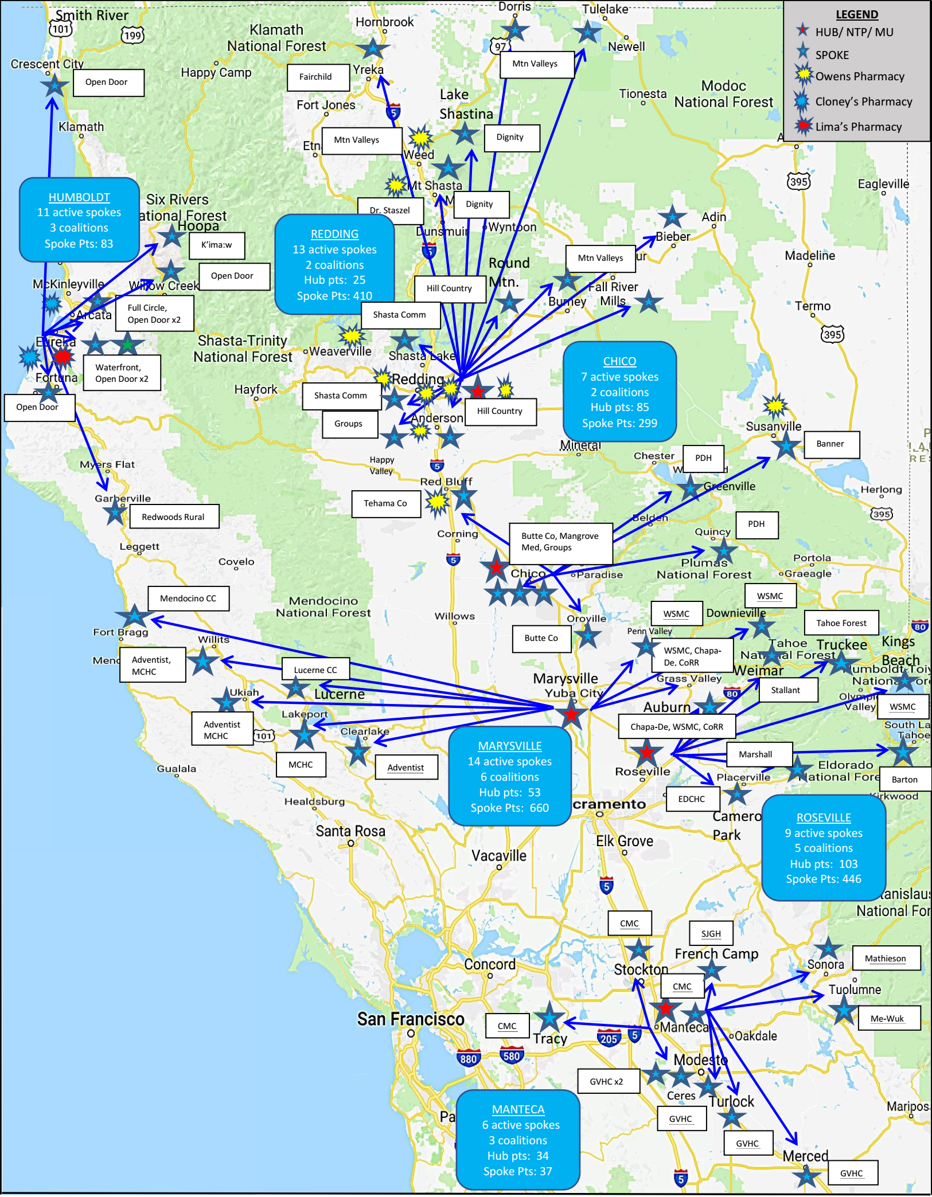
Aegis CA Grant Map
Original Spoke Projections June 2017 Current Hub & Spoke System

Slide 4
H&SS Patient Growth Overall Growth 2,235 total pts

Slide 5
H&SS Patient Growth
Overall Hub Growth 300 total Hub pts
Overall Spoke Growth 1,935 total Spoke pts

Slide 6
Humboldt H&SS
Humboldt H&SS Region Highlights
11 Spokes
3 Coalitions
Contracted with local pharmacies to provide MAT medication to Spokes
ED Bridge collaboration
516 Naloxone kits to the community
Sponsored Opioid education events
Residential Pilot Program
MAT Aftercare Program

Slide 7
Redding H&SS
Redding H&SS Region Highlights
13 Spokes
3 Coalitions
Contracted with local pharmacies to provide MAT medication to Spokes
1716 Naloxone kits to the community
Sponsored Opioid education events
Supported for community OUD awareness film project through SARA Coalition
ED Bridge collaboration

Slide 8
Chico H&SS
Chico H&SS Region Highlights
7 Spokes
3 Coalitions
Contracted with local pharmacies to provide MAT medication to Spokes
264 Naloxone kits to the community
Naloxone for Camp Fire evacuees (OD’s in shelter)
2018 California Opioid Summit w/ Butte County Public Health
Vivitrol MAT spoke with Tehama County

Slide 9
Marysville H&SS
Marysville H&SS Region Highlights
14 Spokes
2 Tribal Spokes – Chapa-De Indian Health Center and Lake County Tribal Health Consortium
6 Coalitions
Contracted with local pharmacies to provide MAT medication to Spokes
744 Naloxone kits to the community
White Bison Training to provide culturally sensitive SUD training for native populations
Community Education Summits facilitated quarterly by Spokes and Coalitions
ED Bridge collaboration

Slide 10
Roseville H&SS
Roseville H&SS Region Highlights
10 Spokes
5 Coalitions
Contracted with local pharmacies to provide MAT medication to Spokes
768 Naloxone kits to the community
Selected as SAMHSA Hub site (one of only two in original 19 grants)
Joined Placer-Nevada Coalition for televised Press Release to celebrate over 100th lives saved by Naloxone in 2018 w/ Assemblymen Dahle & Kiley, Placer & Grass Valley PD
Radio PSA that aired in 4 Counties & 7 radio stations to discuss MAT/Opioid Epidemic.
Opioid Summit in El Dorado County
ED Bridge collaboration

Slide 11
Manteca H&SS
Manteca H&SS Region Highlights
6 Spokes, 2 are tribal spokes – Me- Wuk Indian Health Center and Mathieson Memorial Health Clinic
3 Coalitions
2,418 community Naloxone
Law Enforcement (Sheriffs dept, probation, SWAT team medics, field officers, detective units)
University of the Pacific
Opioid Coalitions
Community Educational Events
10 of 11 Spokes are new to MAT!
Partnering with Stanislaus County Behavioral Health for Opioid Summit
1,000 projected attendees

Slide 12
Hub and Spoke Services
MAT Team Salary
Patient Provider visits
Treatment for Underinsured and Uninsured Patients
MAT Medications & Naloxone
HIV/HCV & Urinalysis Testing
Education/Training Funding
Training Materials for MAT Program
Outreach & Advertisement
Opioid Coalition Funding
Naloxone for Law Enforcement, First Providers, Community
Medication Neutralizers (Deterra & Dispose Rx)
Lock Boxes
Patient Transportation
Telehealth Equipment
Implementation Infrastructure

Slide 13
H&SS Spoke Partners
Adventist Health
Barton Health
Banner Health Clinic
Butte County Behavioral Health
Chapa- De Indian Health Center
Community Recovery Resources
County of Tehama Human Services Agency
Dignity Health
Dr. Staszel
El Dorado Community Health Centers
Fairchild Medical Center
Full Circle for Integrative Medicine
Groups Recover Together
Hill Country Community Clinic
K’ima:w Medial Center
Lake County Tribal Health Consortium
Lucerne Community Clinic
Mangrove Medical Group
Marshall Medical Center
Mendocino Coast Clinics
Mendocino Community Health Clinic
Mountain Valley’s Health Centers
Open Door Community Health Centers
Plumas District Hospital
Redwoods Rural Health Center
Shasta Community Health Center
Stallant Health
Tahoe Forest Hospital
Waterfront Recovery Services
Western Sierra Medical Clinic

Slide 14
H&SS Coalition Partners
Butte Glenn Medical Society Drug Abuse Prevention Task Force
CoRR Youth Based Prevention
Drug Free Coalition- South Lake Tahoe
Drug Free Coalition- Tahoe and Truckee
El Dorado County Opioid Coalition
Hoopa Community Coalition
Lake County Safe Rx
Mendocino/Fort Bragg Safe Rx
Mendonoma Health Alliance
Northern Sierra Opioid Safety Coalition
Rx Safe Del Norte
Rx Safe Humboldt
San Joaquin County Opioid Coalition
Sierra Medical Foundation- Placer Nevada Safe Rx
Siskiyou County Rx Addiction
Stanislaus County Opioid Coalition
Tehama County Opioid Coalition
Trinity Opioid Safety Coalition
Tuolumne County Opioid Coalition
Yuba Sutter Health Council

Slide 15
H&SS Naloxone Distribution

Slide 16
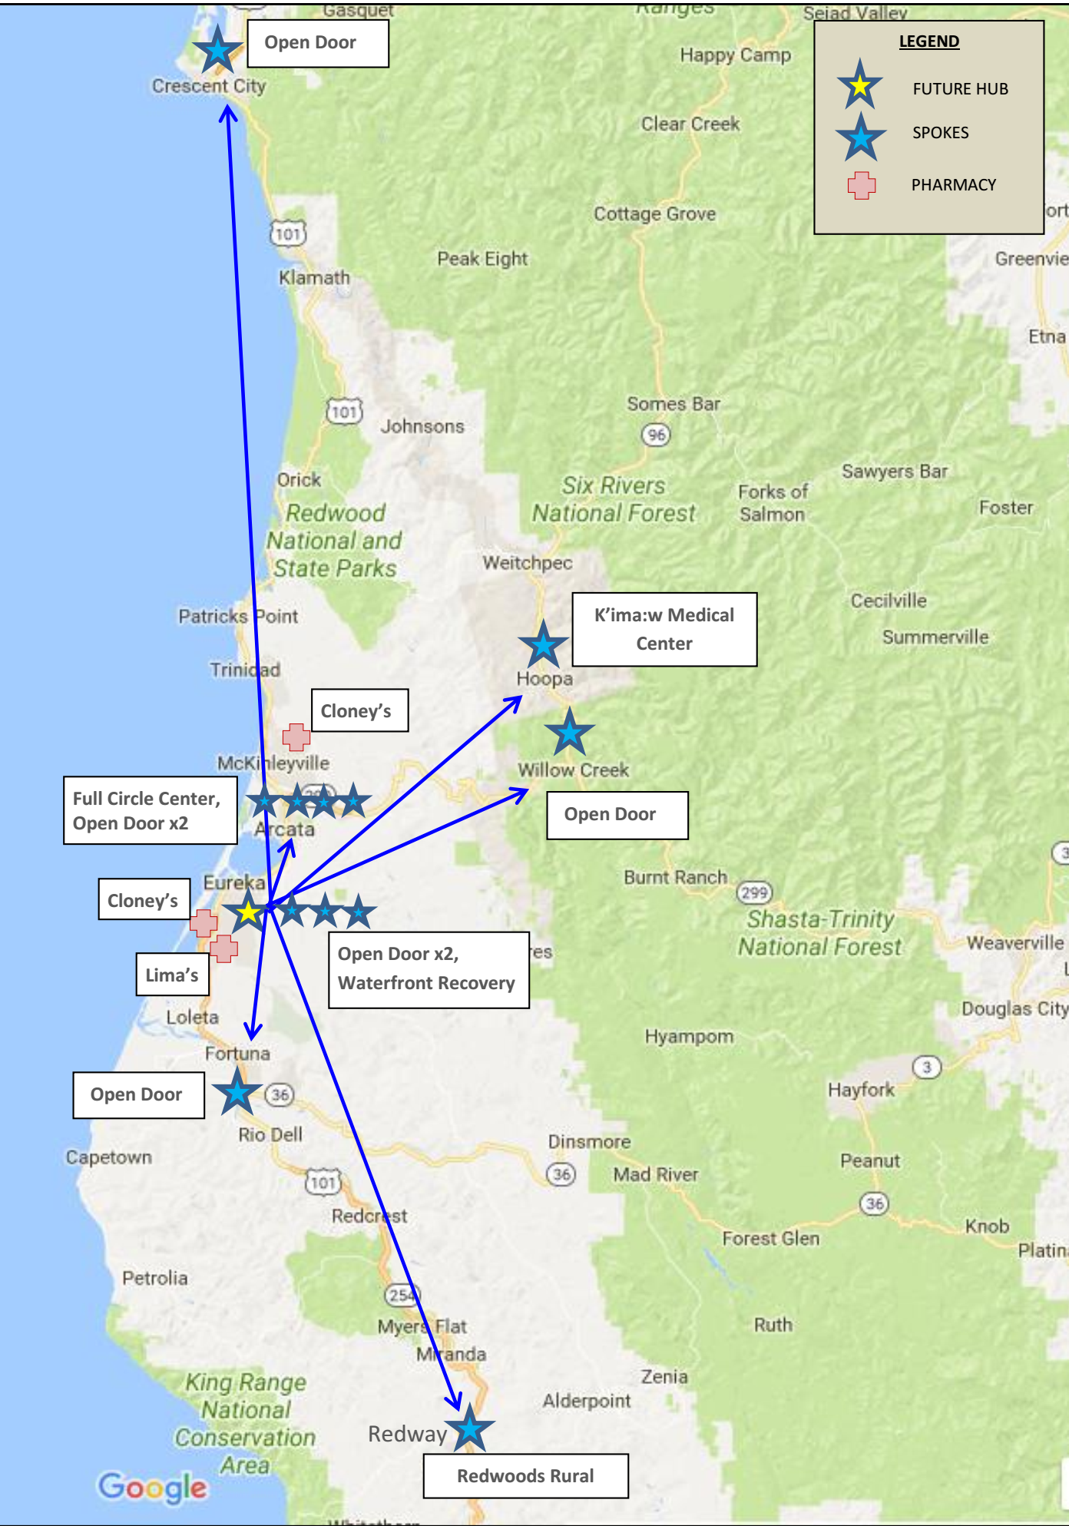
Humboldt H&SS Grant Region
11 Spoke Locations
Redwoods rural Health Center
Redway
Waterfront Recovery Services
Eureka
Full Circle Center for Integrative Medicine
Arcata
K’ima:w Medical Center
Hoopa
Open Door Community Health Centers
Crescent City, Eureka x2, Fortuna, Arcata x2, Willow Creek
2 Pharmacies
Cloney’s
Lima’s
3 Coalitions
Rx Safe Humboldt
Rx Safe Del Norte
Hoopa Community Coalition

Slide 17
Humboldt H&SS Highlights
Residential MAT Pilot
H&SS funding for residential bed nights for Waterfront Recovery Services MAT pts
Funds 30 detox & 90 longer term residential bed nights per month
MAT Aftercare Program
Waterfront Recovery Services new program to allow patients to receive treatment in transition from MAT residential care to MAT primacy care
ED Bridge Collaboration
Collaborated with St. Joes & CA ED Bridge team to help get pts on Buprenorphine in the ED & transferred to spoke partners for MAT
Naloxone Distribution
516 kits to law enforcement, public health, coalitions, community events
202 reported naloxone reversals!

Slide 18
Humboldt Opioid Coalitions

Slide 19
Humboldt H&SS Challenges
MAT Access: Open Door Community Health Centers was one of the only MAT providers in Humboldt County and were treating apr. 500 OUD pts with Medication Assisted Treatment
Beyond Open Door there were Limited Prescribers & MAT Patient Capacity
In Humboldt County
7% of prescribers have a Data 2000 Waiver
Many of these are not utilizing their Waiver to RX Buprenorphine
Most are not treating the maximum number of patients they could
Even though 500 pts were in MAT with Open Door, the Urban Institute estimated that an additional 800 people with OUD in the county were without local access to MAT treatment in 2016
Waitlists to receive MAT treatment
MAT staff recruiting
Limited number of Data Waived Providers, Nurses, Clinicians in rural areas
Transportation especially in winter
Lack of physical space in busy PCP practices

Slide 20
Q&A
Sarah Khawaja, Psy.D.
CA H&SS Grant Manager
Contact Information:
Cell: 916-220-2753
Email: skhawaja@aegistreatmentcenters.com
Notes:
Thank you. Questions?

