Slide 1


Mental Health in California
Catherine Teare
Associate Director, High-Value Care
Joint Assembly and Senate Health Committee Informational Hearing
February 26, 2019

Slide 2
Overview
Sources
Prevalence
Access to care
Medi-Cal
Impact

Slide 3
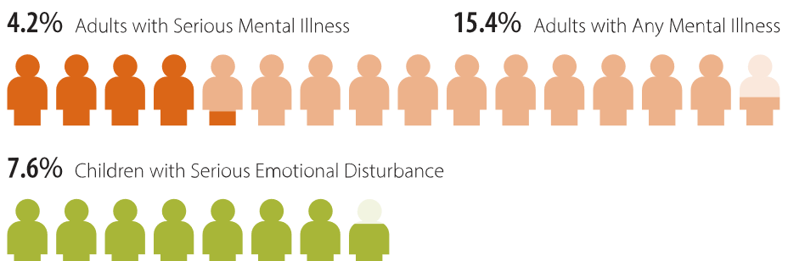
Mental illnesses are common, chronic health conditions
Incidence of Mental Illness, Adults and Children, California, 2014
Source: Charles Holzer and Hoang Nguyen, “Estimation of Need for Mental Health Services,” accessed December 22, 2017, charlesholzer.com.

Slide 4
Prevalence varies by region
Adults with SMI and Children with SED, by Region, California, 2014
Source: Charles Holzer and Hoang Nguyen, “Estimation of Need for Mental Health Services,” accessed December 22, 2017, charlesholzer.com.

Slide 5
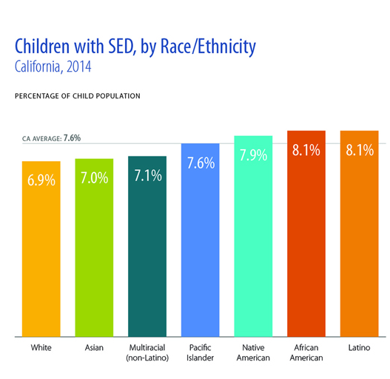
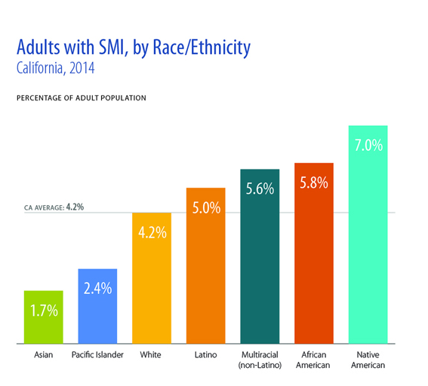
Prevalence varies by race/ethnicity
Source: Charles Holzer and Hoang Nguyen, “Estimation of Need for Mental Health Services,” accessed December 22, 2017, charlesholzer.com.

Slide 6
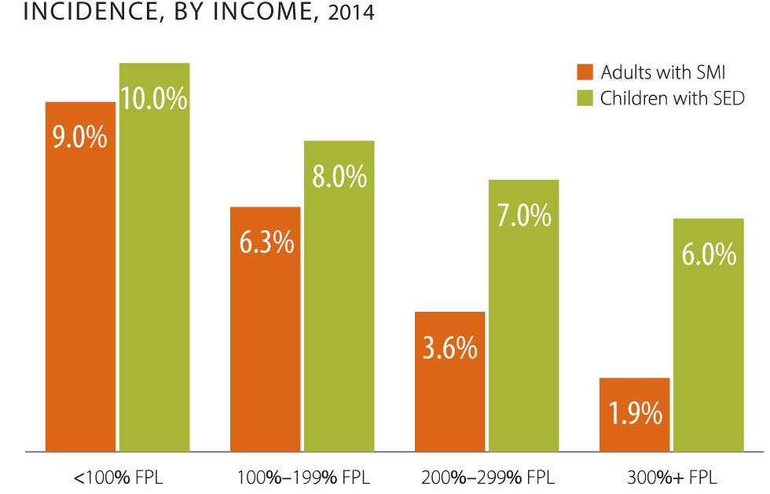
Prevalence varies by income
Source: Charles Holzer and Hoang Nguyen, “Estimation of Need for Mental Health Services,” accessed December 22, 2017, charlesholzer.com.

Slide 7
Depressive illness has risen among adolescents
Reported Having an Major Depressive Episode
Adolescents, California, 2011 to 2015
Source: Behavioral Health Barometer: California, Volume 4, Substance Abuse and Mental Health Services Administration, 2017, www.samhsa.gov (PDF).

Slide 8
Many people with mental illnesses also have substance use disorders
Adults with SMI and SUD and Children with SED and SUD
California, 2011 to 2015, Selected Years
Sources: California Mental Health National Outcome Measures (NOMS): SAMHSA Uniform Reporting System, 2011–2015, www.samhsa.gov; Sarra Hedden et al., Behavioral Health Trends in the United States: Results from the 2014 National Survey on Drug Use and Health, Substance Abuse and Mental Health Services Administration, 2015, www.samhsa.gov (PDF).

Slide 9
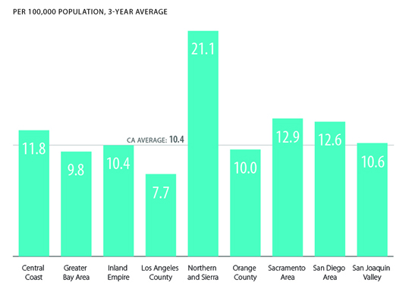
Suicide rates are highest in northern California
Suicide Rate, by Region
All Ages, California, 2011 to 2013
Source: Charles Holzer and Hoang Nguyen, “Estimation of Need for Mental Health Services,” accessed December 22, 2017, charlesholzer.com.

Slide 10
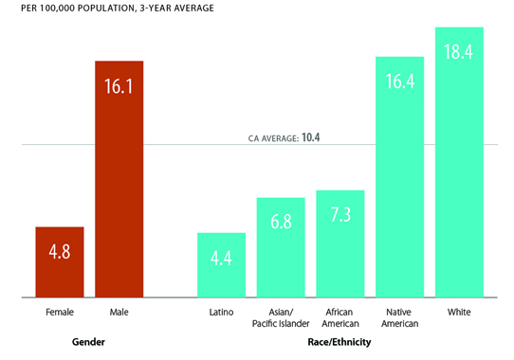
Suicide rates vary by gender and race/ethnicity
Suicide Rate, by Gender and Race/Ethnicity
All Ages, California, 2011 to 2013
Source: Charles Holzer and Hoang Nguyen, “Estimation of Need for Mental Health Services,” accessed December 22, 2017, charlesholzer.com.

Slide 11
Many California adults with mental illness do not receive treatment
Treatment for Mental Illness
Adults with any mental illness, California 2011 to 2015
Percentage who…
Sources: Behavioral Health Barometer: California, Volume 4, Substance Abuse and Mental Health Services Administration, 2017, www.samhsa.gov (PDF); Larry Goldman, Nancy Nielsen, and Hunter Champion, “Awareness, Diagnosis, and Treatment of Depression,” Journal of General Internal Medicine 14, no. 9 (September 1999): 569–80.

Slide 12
Access for adolescents reporting major depression is particularly limited
Treatment for Major Depressive Episode
Adolescents, California, 2011 to 2015
Percentage reporting MDE in the past year who…
Source: Behavioral Health Barometer: California, Volume 4, Substance Abuse and Mental Health Services Administration, 2017, www.samhsa.gov (PDF).

Slide 13
Medi-Cal and other public programs play a critical role in financing mental health care
All Health vs. Mental Health Expenditures
By Payer, United States, 2015
Source: “Table A.7,” in Projections of National Expenditures for Treatment of Mental and Substance Use Disorders, 2010–2020, Substance Abuse and Mental Health Services Administration, 2014: A-12 and A-13, store.samhsa.gov.

Slide 14
600,000 Californians receive Medi-Cal specialty mental health services
Adults and Children, California, FY 2012 to 2015
Source: Statewide Aggregate Specialty Mental Health Services Performance Dashboard, California Department of Healthcare Services, 2016, www.dhcs.ca.gov (PDF).

Slide 15
People with behavioral health disorders die far too young
People with serious mental illness die 25 years earlier
People with a substance use disorder die 22.5 years earlier
Many of these deaths are from preventable physical illnesses.

Slide 16
Cost of care is much higher for people who both behavioral and physical health conditions
Medi-Cal Spending on Diabetes, by Service Category
With and Without SMI or AD, California, 2011
Source: Understanding Medi-Cal’s High-Cost Populations, Department of Health Care Services, June 2015, www.dhcs.ca.gov (PDF).

Slide 17


