Slide 1
Joint Assembly and Senate Informational Hearing
Health Insurance Affordability Assistance for Californians: Options and Funding
Peter V. Lee
Executive Director
February 12, 2019

Slide 2
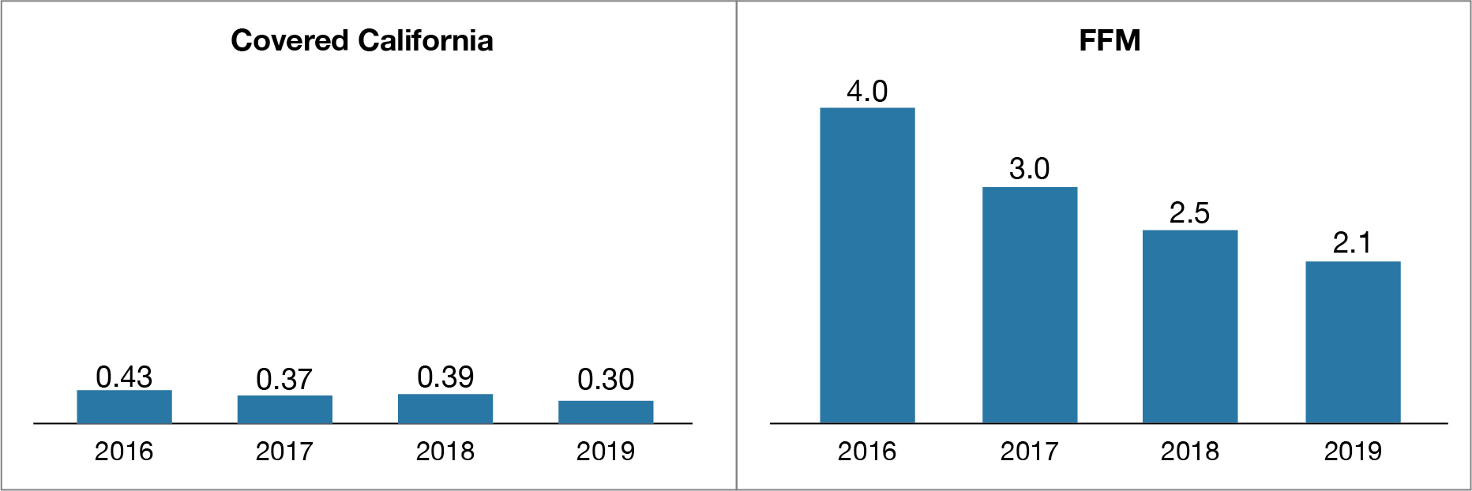
WHILE COVERED CALIFORNIA’S TOTAL ENROLLMENT HELD STEADY, THE DROP IN NEW ENROLLEES IS A CONCERN AT THE STATE AND FEDERAL LEVEL
Covered California’s drop in new enrollees of 24 percent surpassed the 16 percent decline in the 39 states represented by the federal marketplace. The decline in those states was on top of a 39 percent decrease in new enrollees between 2016 and 2018, while California has maintained more new enrollees each year and a 200 percent healthier risk mix.
Comparing New Enrollment, Covered California and FFM, 2016-19, in millions
Covered California 2019 Open Enrollment Early Analysis
https://hbex.coveredca.com/data-research/library/CoveredCA_2019_Open_Enrollment_Early_Analysis.pdf

Slide 3

OPTIONS TO IMPROVE AFFORDABILITY IN CALIFORNIA’S INDIVIDUAL HEALTH INSURANCE MARKET
Developed pursuant to AB 1810 (Committee on Budget, Chapter 34, Statutes of 2018), to develop and present options to improve affordability for low- and middle-income Californians to the Governor, Legislature, and Council on Health Care Delivery Systems.
Five-month engagement of academic experts and Covered California’s Policy Division with a workgroup of stakeholders, legislative staff and broad community input.
Report presents multiple options to improve affordability in the individual market building on tools of the Affordable Care Act.
Report available at: https://hbex.coveredca.com/data-research/library/CoveredCA_Options_To_Improve_Affordability.pdf

Slide 4
COMPREHENSIVE MARKET-WIDE AFFORDABILITY MODELS
Policy Option | Description | Policy Objectives
Option 1: Enhance and extend premium and cost-sharing support | Premium support that lowers premium contribution caps for individuals up to 400% FPL and new premium support above 400% FPL that eliminates the cliff Cost-sharing support that expand eligibility for, and generosity of, cost-sharing program for individuals between 150% and 400% FPL | Significantly increase enrollment among those eligible for individual market coverage Cap premium contributions for all individual market enrollees by eliminating the tax credit cliff Make care more affordable for all enrollees under 400 percent FPL
Option 2: Enhance and extend premium and cost-sharing support plus individual mandate penalty | Option 1 plus reinstatement of individual mandate penalty | All Option 1 objectives Restore a significant share of projected enrollment loss in the individual market due to zero-dollar federal penalty Lower gross premiums through improved risk mix
Option 3: Enhance and extend premium and cost-sharing support plus individual mandate penalty plus reinsurance | Option 2 plus funding for a reinsurance program modeled on the temporary federal reinsurance program funded at the level required to lower gross premiums by 10 percent per year | All Option 2 objectives Reduce individual market gross premiums by 10 percent per year to address affordability for individuals who do not receive premium subsidies.

Slide 5
TARGETED AFFORDABILITY MODELS
Policy Objective | Policy Option | Description
Targeted improved affordability for consumers earning less than 400% FPL | T1 | Premium support that lowers premium contribution caps for individuals up to 400% FPL
 | T2 | Cost-sharing reduction so that those 200-400% FPL get AV 80 plans (Gold AV)
Targeted improved affordability for consumers earning less than 600% FPL | T3 | Premium support that lowers premium contribution caps under 400% FPL and extends the cliff to 600% FPL
 | T4 | Premium support and penalty reinstatement Option T3 Reinstate individual mandate penalty
Targeted improved affordability for consumers earning more than 400% FPL | T5 | Premium support between 400 and 600% FPL that pushes out the cliff
 | T6 | Premium support above 400% FPL that eliminates the cliff
 | T7 | Reinsurance that lowers premiums by 10 percent per year
Targeted improved affordability for all consumers generated by reinstating the mandate penalty | T8 | Reinstate individual mandate penalty

Slide 6
AFFORDABILITY REMAINS CRITICAL CHALLENGE FOR MIDDLE INCOME CONSUMERS
Consumer share of premium (grey bars) jump for those just over the “subsidy cliff” at 400 percent of Federal Poverty Level (FPL). The impact is most severe for older consumers and those living in regions with higher health care costs.
Monthly Premium and Tax Credit by Age and Income Range in Alameda County

Slide 7
ILLUSTRATING POLICIES THROUGH CONSUMER SCENARIOS
Approach 1, Option 2, Comprehensive Market-Wide Affordable Enhancements
Alfonso 25 years old Lives in a low cost region Income: $25,000 206% FPL Based on the second-lowest Silver plan offered where Alfonso lives |  | Affordable Care Act Baseline | Option 2 Enhanced Premium and Cost Sharing Subsidies with Penalty
 | Monthly Premium (SLS) | $350 | $333
 | Net Premium | $136 | $39
 | Net Premium Income Share | 6.54% | 1.89%
 | Federal Premium Subsidy | $214 | $196
 | New Premium Subsidy | $0 | $97
 | Silver Plan Medical Deductible (family) | $2,200 | $650
 | Annual Penalty | None | $695

Slide 8
ILLUSTRATING POLICIES THROUGH CONSUMER SCENARIOS
Approach 1, Option 2, Comprehensive Market-Wide Affordable Enhancements
Erin and Francis 62 years old Live in a high cost region Income: $75,000 456% FPL Based on the second-lowest Silver plan offered where Erin and Francis live |  | Affordable Care Act Baseline | Option 2 Enhanced Premium and Cost Sharing Subsidies with Penalty
 | Monthly Premium (SLS) | $2,250 | $2,138
 | Net Premium | $2,250 | $578
 | Net Premium Income Share | 36.00% | 9.25%
 | Federal Premium Subsidy | $0 | $0
 | New Premium Subsidy | $0 | $1,559
 | Silver Plan Medical Deductible (family) | $5,000 | $5,000
 | Prorated Monthly Penalty | None | $263

Slide 9
COVERED CALIFORNIA 2019 PATIENT-CENTERED BENEFIT DESIGNS
In California, standard benefit designs allow apples-to-apples plan comparisons and seek to encourage utilization of the right care at the right time with many services that are not subject to a deductible. All health plans offer identical patient-centered benefit designs.
Coverage Category | Bronze | Silver | Gold | Platinum
 | Covers 60% average annual cost | Covers 70% average annual cost | Covers 80% average annual cost | Covers 90% average annual cost
Annual Wellness Exam | $0 | $0 | $0 | $0
Primary Care Visit | $75 | $40 | $30 | $15
Specialty Care Visit | $105 | $80 | $55 | $30
Urgent Care Visit | $75 | $40 | $30 | $15
Emergency Room Facility | Full cost until out-of-pocket maximum is met | $350 | $325 | $150
Laboratory Tests | $40 | $35 | $35 | $15
X-Ray and Diagnostics | Full cost until out-of-pocket maximum is met | $75 | $55 | $30
Medical Deductible | Individual: $6,300 Family: $12,600 | Individual: $2,500 Family: $5,000 | N/A | N/A
Pharmacy Deductible | Individual: $500 Family: $1,000 | Individual: $200 Family: $400 | N/A | N/A
Annual Out-of-Pocket Maximum | Individual: $7,550 Family: $15,100 | Individual: $7,550 Family: $15,100 | Individual: $7,200 Family: $14,400 | Individual: $3,350 Family: $6,700
Benefits shown in blue are not subject to a deductible.
White corner = subject to a deductible after first three visits. The copay is for any combination of services (primary care, specialist, urgent care) for the first three visits.
After three visits, they will be at full cost until the medical deductible is met.

Slide 10
COVERED CALIFORNIA 2019 PATIENT-CENTERED BENEFIT DESIGNS FOR COST-SHARING REDUCTION BENEFIT DESIGNS
Consumers who have a household income between 138% and 250% of the federal poverty level are eligible to enroll in Silver plan with Cost-Sharing Reduction (CSR) benefits.
Coverage Category | Enhanced Silver 94 | Enhanced Silver 87 | Enhanced Silver 73
Eligibility Based on Income and Premium Assistance | Covers 94% average annual cost | Covers 87% average annual cost | Covers 73% average annual cost
Single Income Ranges | up to $18,210 (≤150% FPL) | $18,211 to $24,280 (>150% to ≤200% FPL) | $24,281 to $30,350 (>200% to ≤250% FPL)
Annual Wellness Exam | $0 | $0 | $0
Primary Care Visit | $5 | $15 | $35
Specialty Care Visit | $8 | $25 | $75
Urgent Care Visit | $5 | $15 | $35
Emergency Room Facility | $50 | $100 | $350
Laboratory Tests | $8 | $15 | $35
X-Ray and Diagnostics | $8 | $30 | $75
Imaging | $50 | $100 | $300
Medical Deductible | Individual: $75 Family: $150 | Individual: $650 Family: $1,300 | Individual: $2,200 Family: $4,400
Pharmacy Deductible | — | Individual: $50 Family: $100 | Individual: $175 Family: $350
Annual Out-of-Pocket Maximum | Individual: $1,000 Family: $2,000 | Individual: $2,600 Family: $5,200 | Individual: $6,300 Family: $12,600
Benefits shown in blue are not subject to a deductible.

Slide 11
Information for consumers
CoveredCA.com
Information on exchange-related activities
hbex.CoveredCA.com

