Slide 2
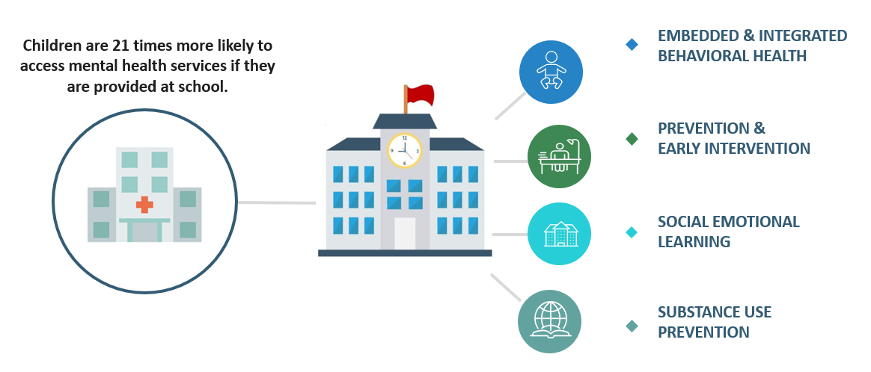
A SCHOOL-BASED APPROACH TO BEHAVIORAL HEALTH
American Psychological Association, Schools expand mental health care. Journal of Adolescent Health, 2003. Vol. 32, No. 6. Kaplan,

Slide 3
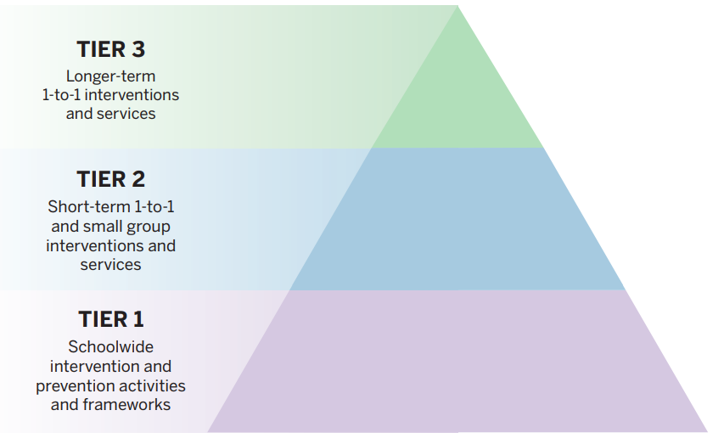
SCHOOL-BASED BEHAVIORAL HEALTH NON-ONE TIME RESOURCES
County Behavioral Health SMHS
Managed Care Billing (Starting 2024)
LEA Billing Option Program
Prop 63 Prevention & Early Intervention

Slide 4
The Efficacy of a School-Based Approach to Student Wellness
http://bit.ly/wellnessbrief
Youth at the Center
https://www.chhs.ca.gov/wp-content/uploads/2023/01/CYBHI-Youth-at-the-Center-Report.FINAL_.pdf
Supporting California’s Children Through a Whole Child Approach
https://cacfs.memberclicks.net/assets/2022Policy/Integrated-Care-Field-Guide_ADA.pdf

