Slide 1
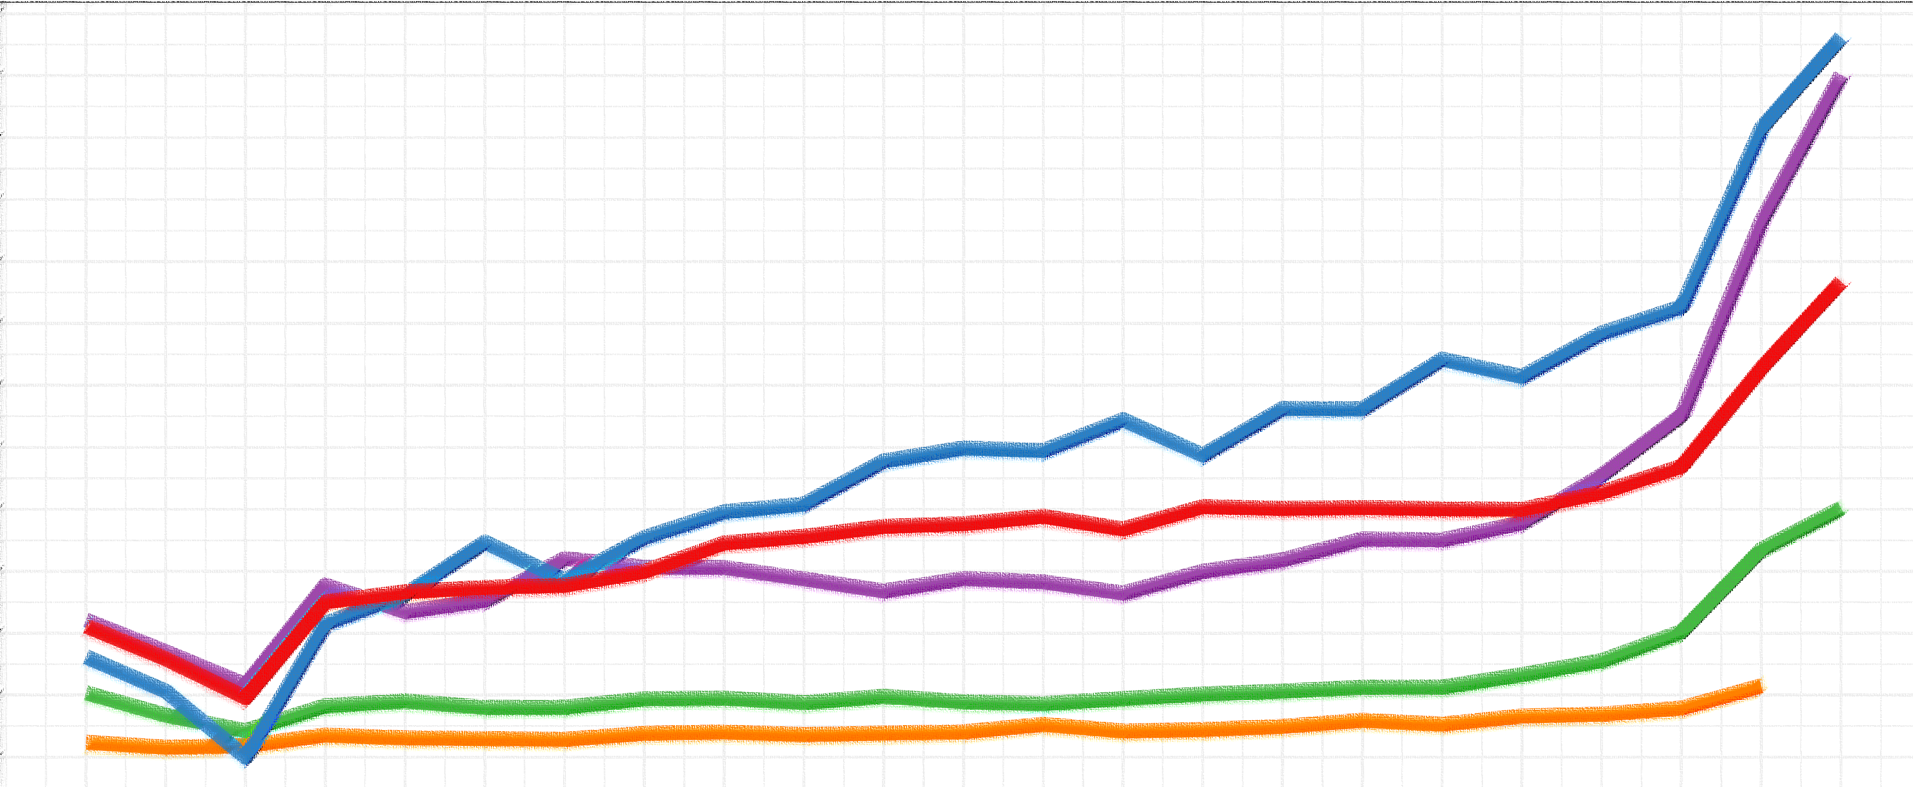


The Overdose Crisis in California: Key Trends
Presented By: Joseph Friedman, PhD, MPH
Center for Social Medicine, UCLA Medical School
Joseph.Robert.Friedman@gmail.com | @JosephRFriedman

Slide 2
Statements made by the presenters do not necessarily represent the views of UCLA or any other funding or associated institution.

Slide 3
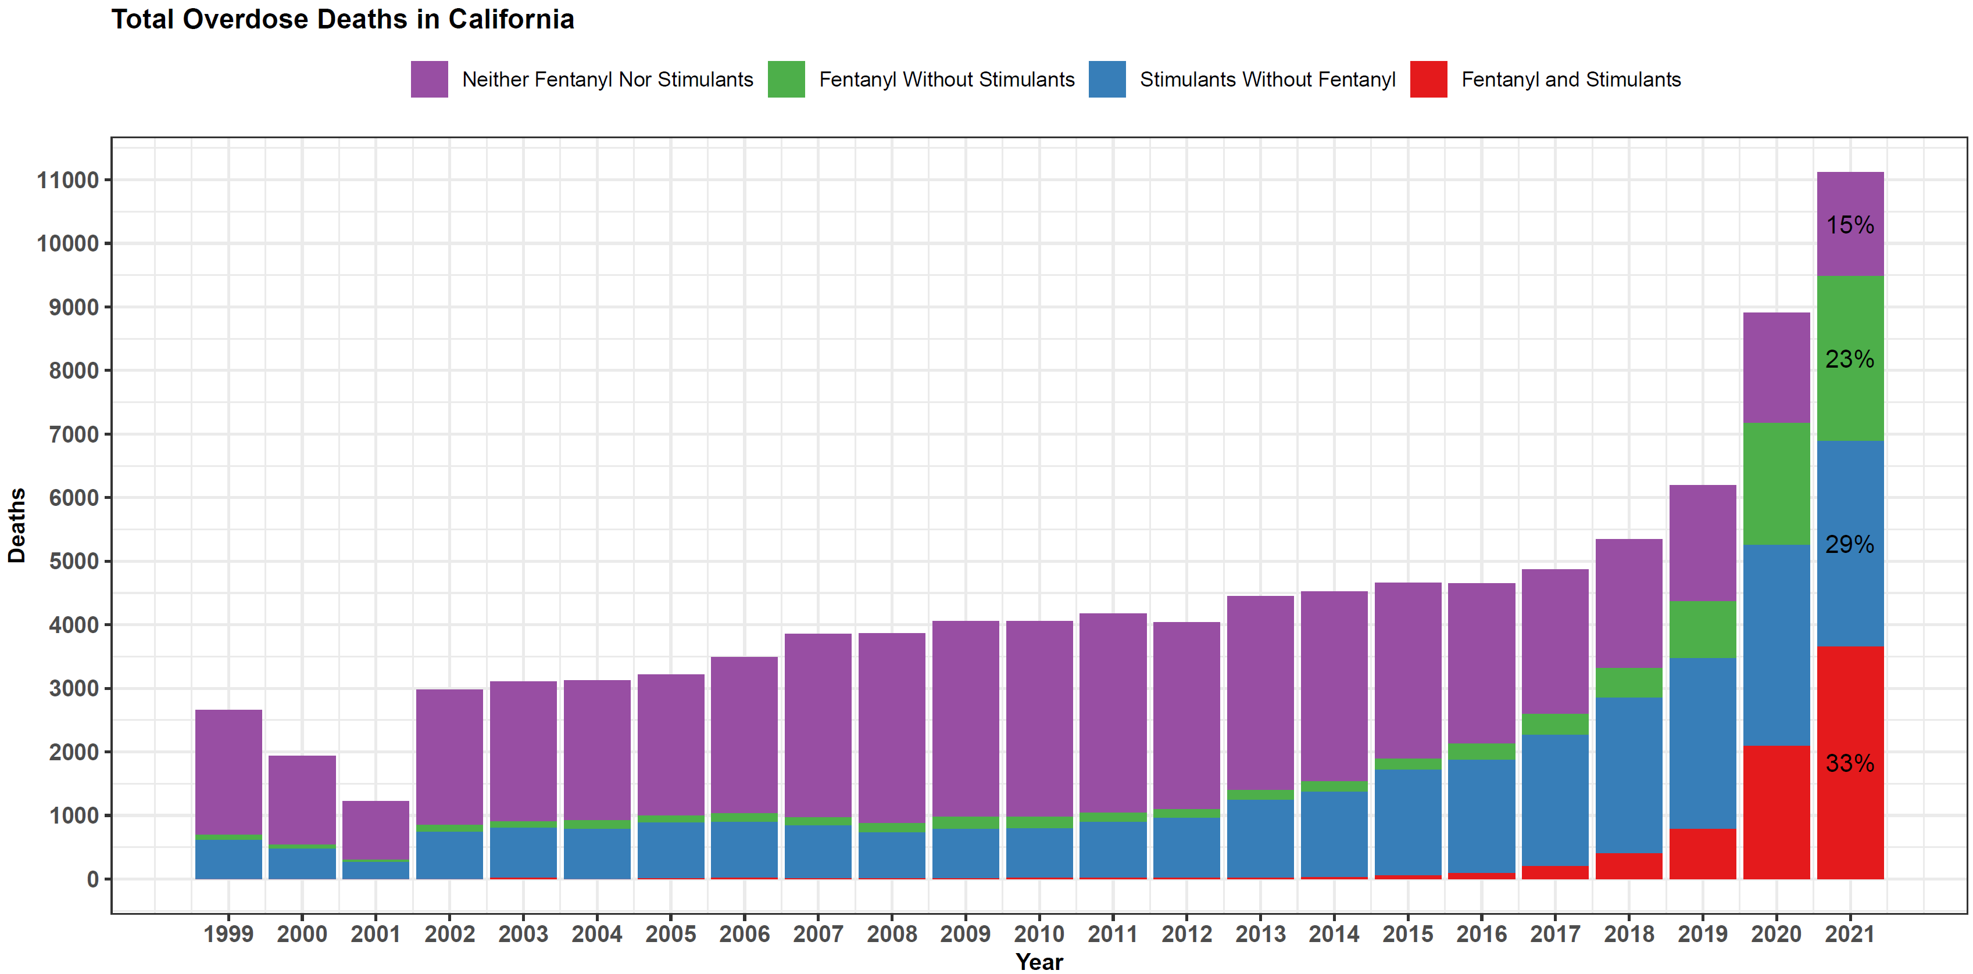
Overdose Deaths in California Are Driven by Fentanyl + Stimulants

Slide 4
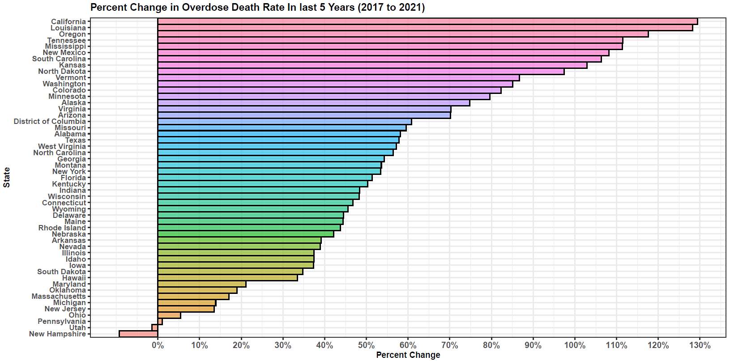
Overdose Rates Are Increasing Faster in California Than Any Other State
California had far more overdose deaths in 2021 (over 11,000) than any other state.

Slide 5
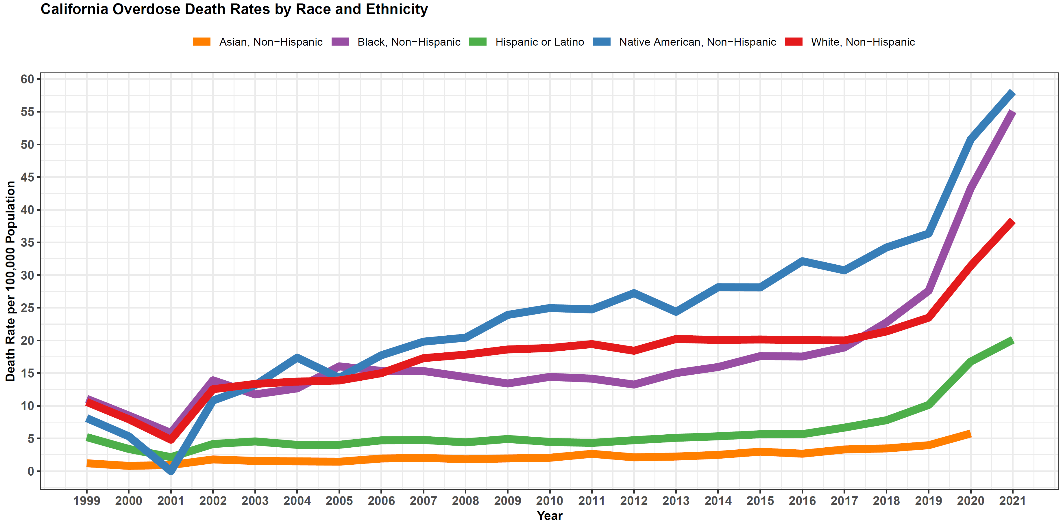
Black and Indigenous Californians Are the Most Affected
Black Death Rate 44 % Higher than White
Native Death Rate 51% Higher than White

Slide 6
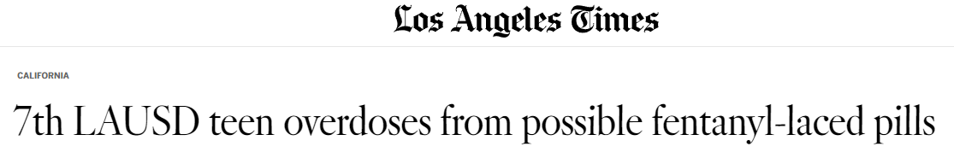

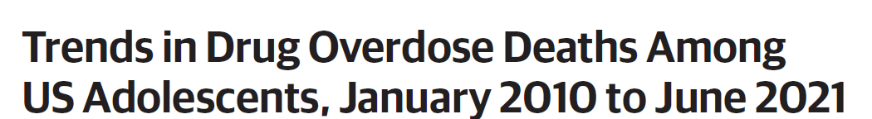

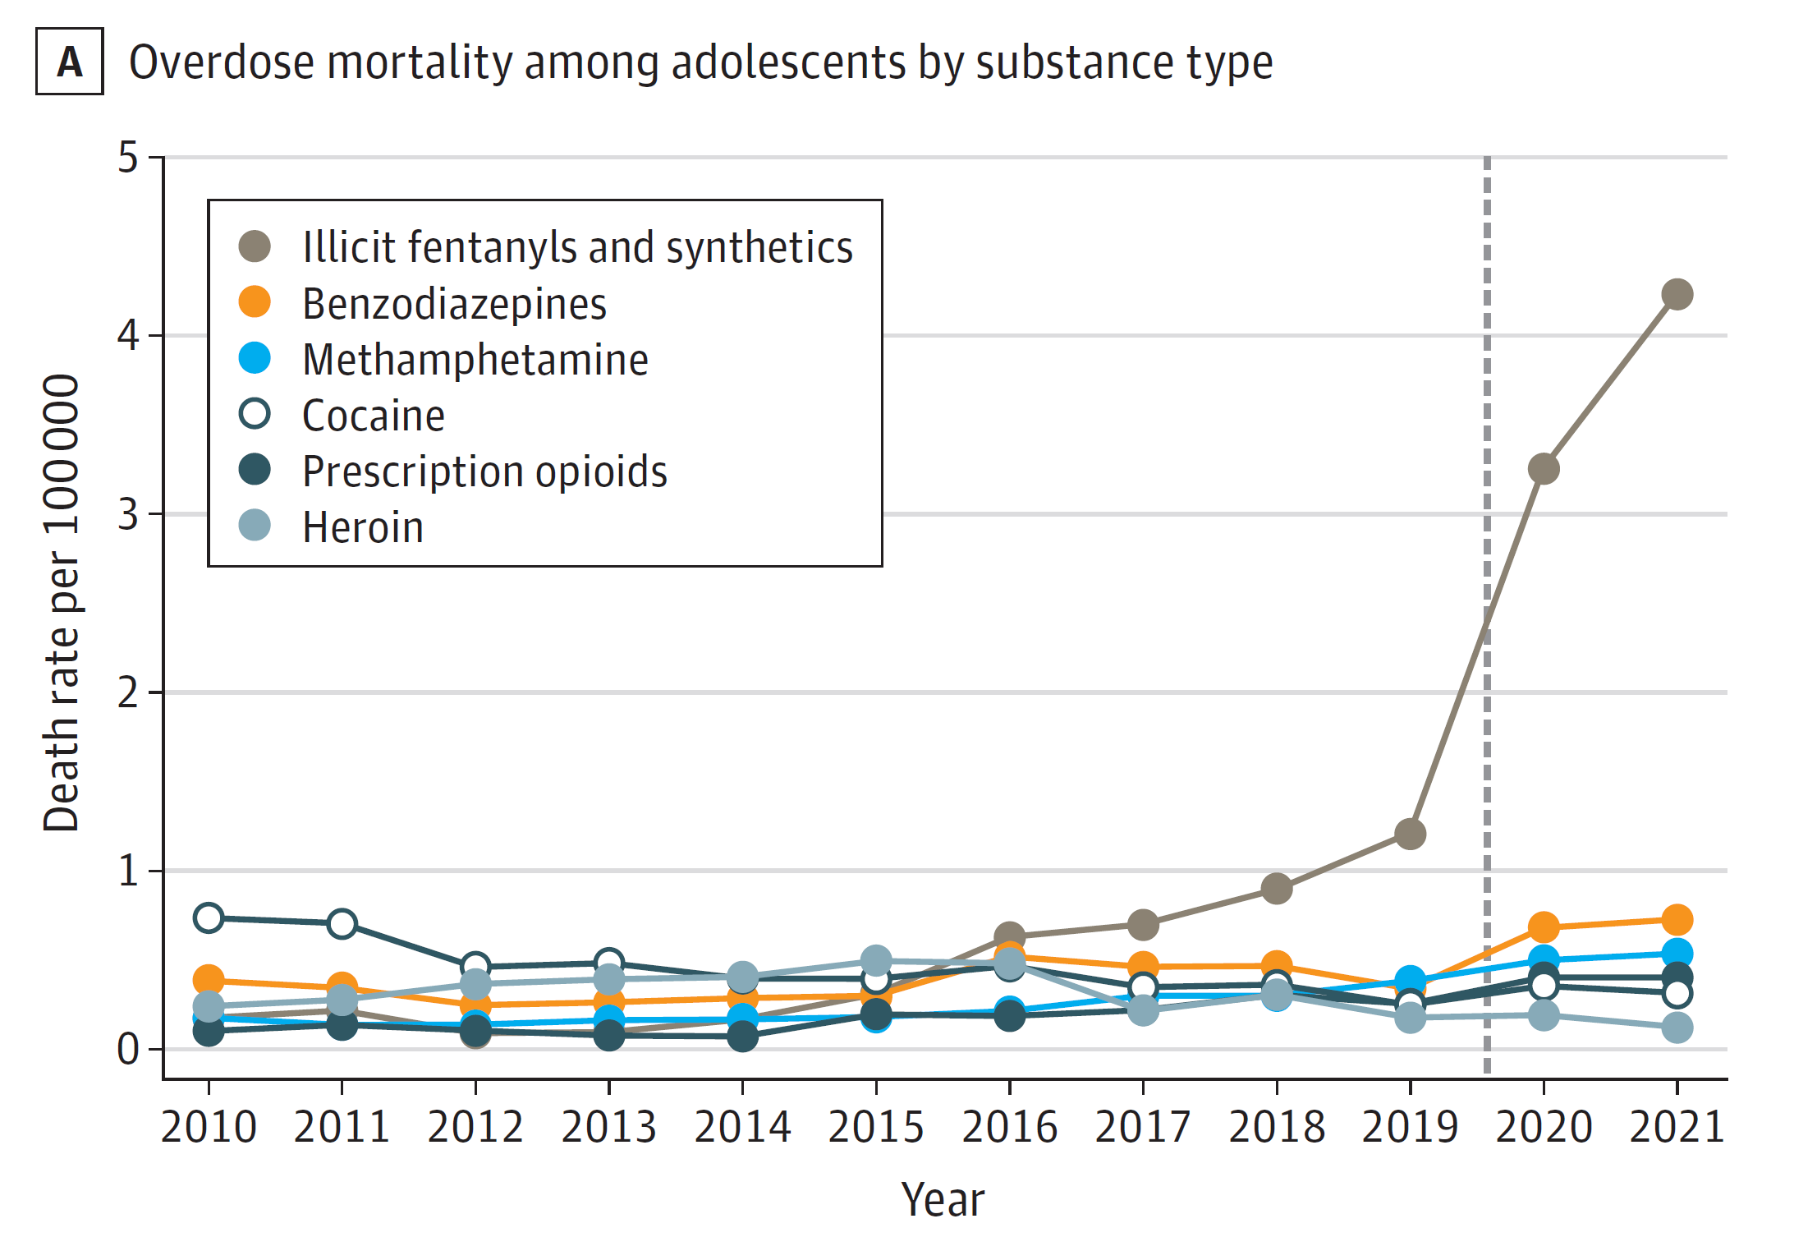
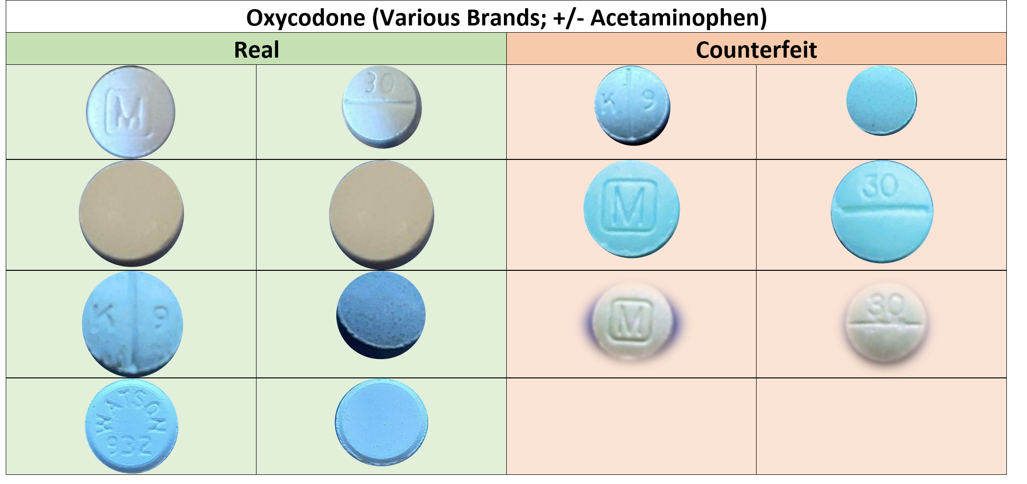
Counterfeit Pills Are Driving Risk for California Teens

Slide 7


Articles Referenced
Joseph Friedman, PhD, MPH
Center for Social Medicine, UCLA Medical School
Joseph.Robert.Friedman@gmail.com | @JosephRFriedman

Slide 8
Overview of the Opioid Crisis and Evaluation of State Programs
Joint Hearing of the Senate Public Safety Committee and the Senate Health Committee
February 27, 2023
Richard Rawson, Ph.D.

Slide 9
Fentanyl

Slide 10
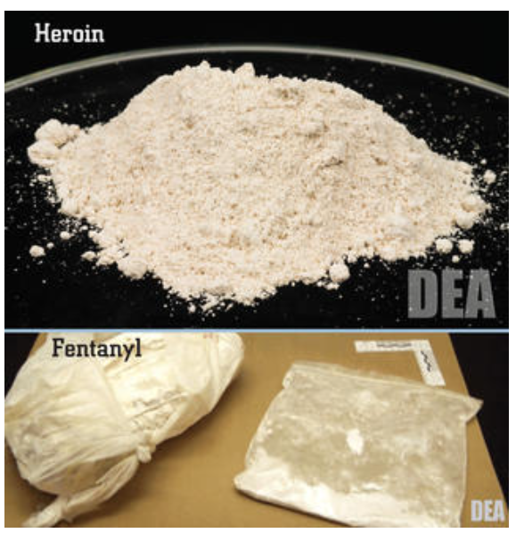
Fentanyl and heroin

Slide 11
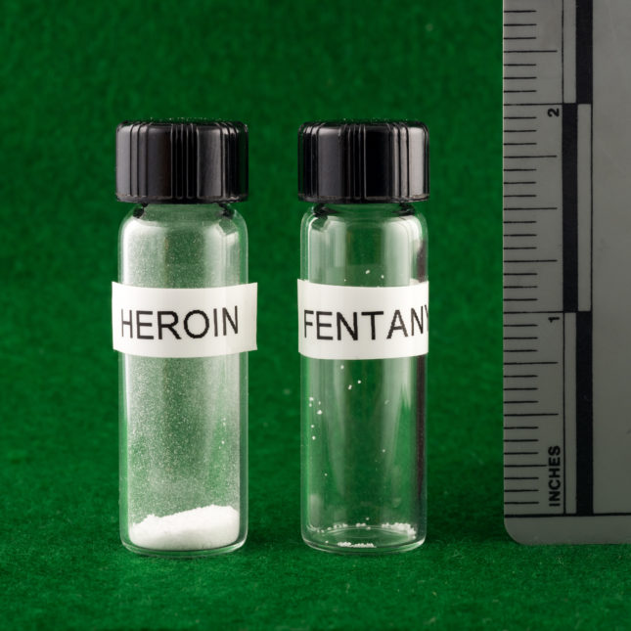
A lethal dose
30mg
3mg

Slide 12
Overdose and Origins
From May 2020 to April 2021 more than 100,000 Americans died for a drug overdose.
64% of these deaths were due to synthetic opioids like fentanyl.
Fentanyl is synthesized in China, Mexico and, India and exported to The U.S. as a powder or pressed in pills.
A 5 lb bag of fentanyl is enough to produce 1,000,000 lethal doses

Slide 13
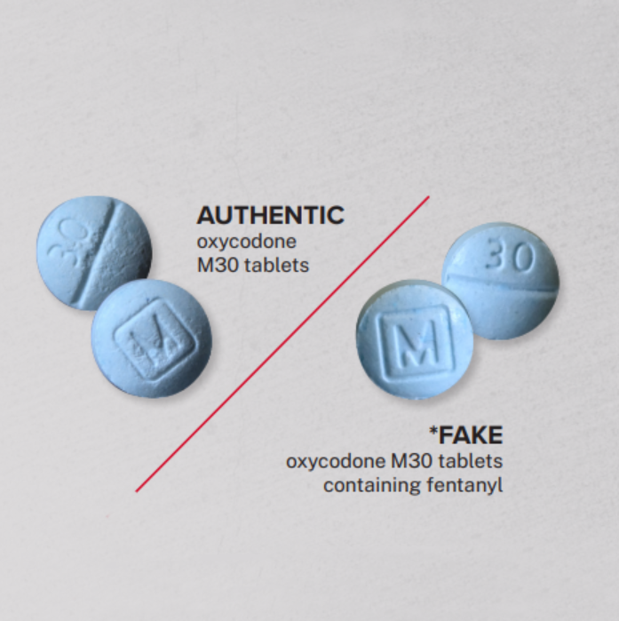
Fake “Oxys” M30s

Slide 14
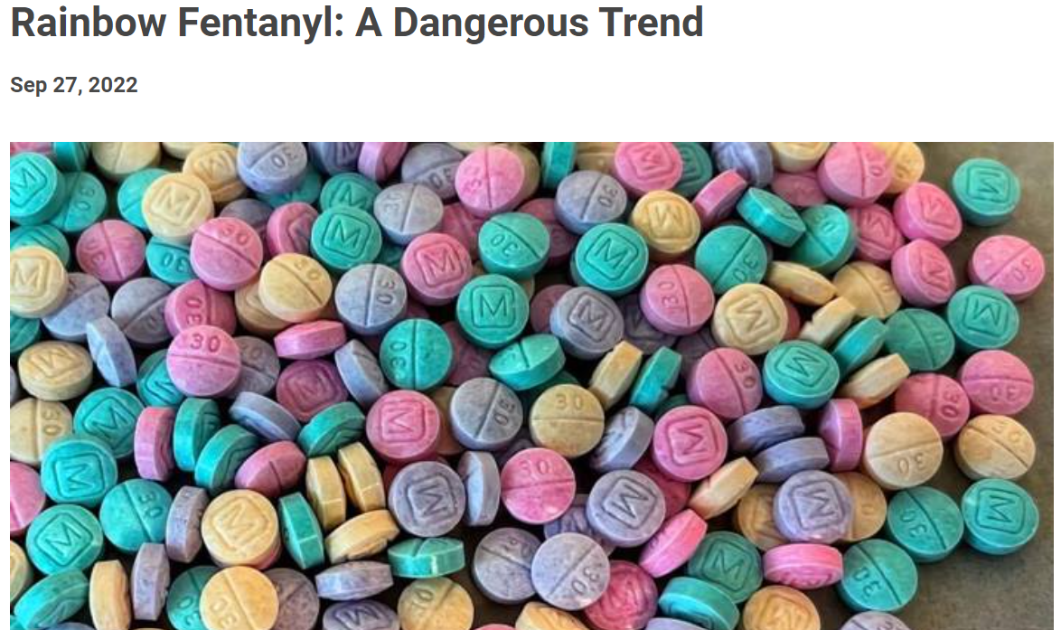
Rainbow fentanyl

Slide 15
The Fentanyl Problem
Fentanyl and its analogs are the primary drivers of death in the opioid overdose crisis.
Fentanyl is 50 times stronger than heroin.
Unintended use, particularly by people with no or low opioid tolerance, has resulted in a spike in drug overdose deaths.
Overdose can occur by ingestion, injection, or inhalation.
Overdose by fentanyl can not occur by exposure through skin.
Reversal of fentanyl overdose may require repeated doses of naloxone

Slide 16
Testing for Fentanyl
Fentanyl test strips (FTS) can detect the presence of fentanyl in drug samples.
FTS cost is $1.00 per strip.
Testing is 96% accurate and can detect at least 10 fentanyl analogs.
The legality of FTS varies from state to state (some states view FTS as illegal drug paraphernalia).

Slide 17
New Fentanyl Compounds
Other fentanyl compounds are appearing in heroin, counterfeit pills and in autopsy findings.
Para-fluorofentanyl was developed through research efforts in the 1960’s and classified as a schedule I substance.
Para-fluorofentanyl is showing up now in seized heroin, counterfeit pills, and autopsy findings.
Carfentanil (100 times more potent than fentanyl) has been reported in a very few cases in the Midwest.

Slide 18
Xylazine

Slide 19
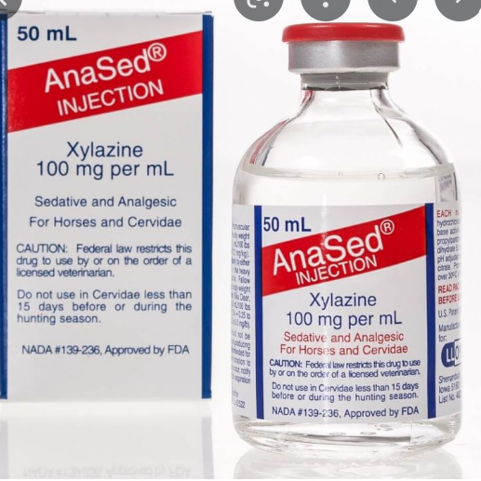
“For horses and cervidae”

Slide 20
Use of Xylazine in veterinary medicine
Xylazine is an essential tool universally used by veterinarians who work on livestock.
Administered intravenously or intramuscularly by a veterinarian
Xylazine is an anesthetic that lasts about an hour.
Xylazine has been studied in humans for its potential use as an analgesic.
Clinical trials were terminated due to its severe hypotension and central nervous system depressant effects.

Slide 21
Xylazine – Pharmacology/Clinical Effects
Clinical Effects
CNS depression
• Major clinical effect is profound sedation
• Imidazoline receptor activity: hypotension/bradycardia
• Time to effect is a 1-2 minutes
• Duration of drug effect up to 4 hours
Xylazine is used together with fentanyl to prolong fentanyl effects

Slide 22
Xylazine information from NIDA
Also known as “tranq,” xylazine is a central nervous system depressant that can cause drowsiness and amnesia and slow breathing, heart rate, and blood pressure to dangerously low levels.
Taking opioids in combination with xylazine and other central nervous system depressants—like alcohol or benzodiazepines increases the risk of life-threatening overdose.

Slide 23
Xylazine in an overdose
In the event of a suspected xylazine overdose, experts recommend giving the opioid overdose reversal medication naloxone because xylazine is frequently combined with opioids. However, because xylazine is not an opioid, naloxone does not address the impact of xylazine on breathing.
Assistance with breathing can be useful in assisting with an overdose involving xylazine.

Slide 24
Treatment of Overdose, Withdrawal, and Wounds Associated with Xylazine
(From D’Orazio 2022)

Slide 25
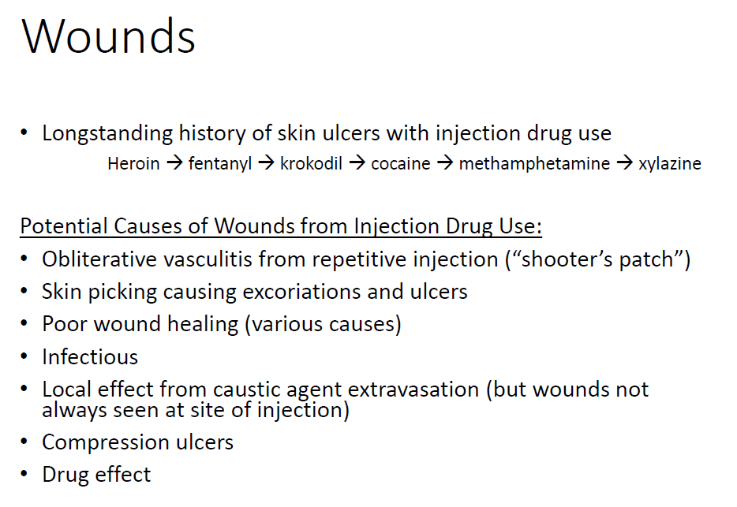

Slide 26
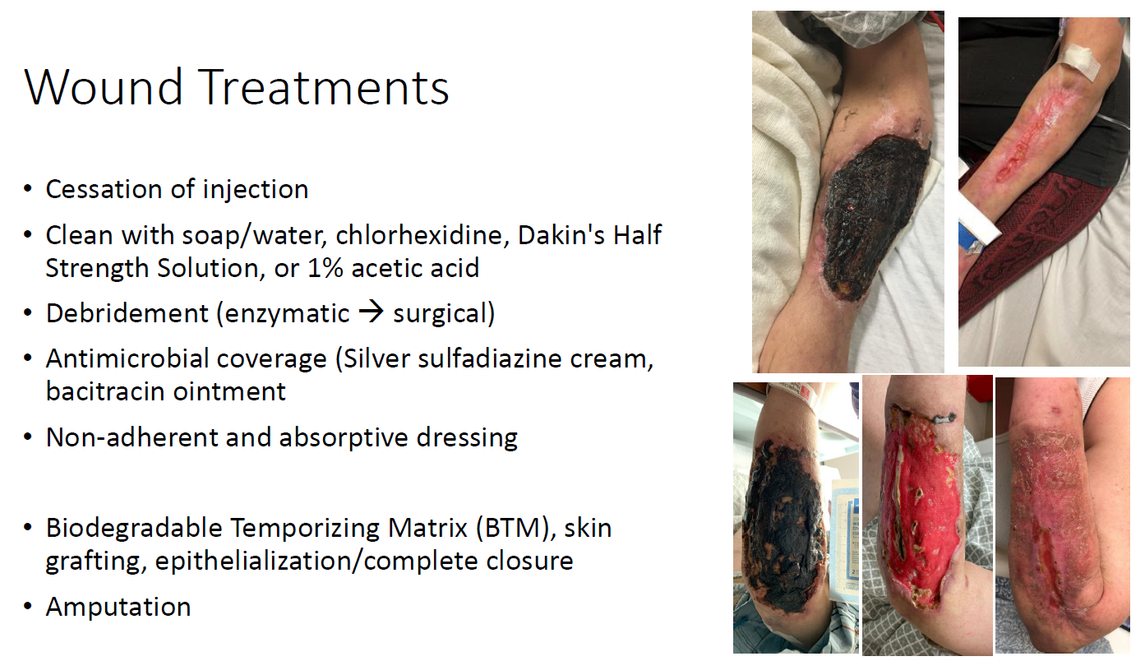

Slide 27
Substance Use Disorders
are Among the Most
Complex and Costly Problems
Facing Our Society

Slide 28
Why Do Individual People
Take Drugs in the First Place?

Slide 29
Initially, A Person Takes A Drug
Hoping to Change their Mood,
Perception, or Emotional State
Translation---
…Hoping to Change their Brain

Slide 30
Another Critical Question…
Why Do Some People
Get Into Trouble With Drugs
And Others Don’t?

Slide 31
Genetics
Gene/
Environment
Interaction
Environment

Slide 32
A Major Reason People
Take a Drug is they Like
What It Does to Their Brains

Slide 33
But Then…
After A Person Uses Drugs
For A While,
Why Can’t They Just Stop?

Slide 34
Because…
Their Brains
have been
Re-Wired
by Drug Use

Slide 35
Addiction is, Fundamentally,
A
Brain Disease
…BUT
It’s Not Just
A Brain Disease

Slide 36
HISTORICAL
PHYSIOLOGICAL
- previous history
- expectation
- learning
DRUGS
- genetics
- circadian rhythms
- disease states
- gender
ENVIRONMENTAL
- social interactions
- stress
- conditioned stimuli
BRAIN
MECHANISMS
BEHAVIOR
ENVIRONMENT

Slide 37

Questions?
RRAWSON@MEDNET.UCLA.EDU

Slide 38
Overview of the Opioid Crisis and Evaluation of State Programs
Joint Hearing of the Senate Public Safety Committee and the Senate Health Committee
February 27, 2023
Darren Urada, Ph.D.

Slide 39
DHCS Projects UCLA is Collecting Data on
Addiction Treatment Starts Here Equity-Centered Community Learning Collaborative and Learning Network
ATLAS Treatment Locator
Behavioral Health Workforce Expansion
Behavioral Health Justice Intervention Services
CA Bridge Program
CDPH Projects
Crisis Care Mobile Units Program
CA Hub & Spoke System
CA Overdose Prevention Network
CA Substance Use Line
CA Youth Opioid Response
CalAIM / Drug Medi-Cal Organized Delivery System
  Recovery Incentives Program: CA’s Contingency Management Benefit
CalAIM Transformation Training for Leadership and Statewide Documentation Training
DUI MAT Integration
First Episode Psychosis Coordinated Specialty Care Learning Collaboratives
Friday Night Live Youth Prevention
MAT Access Points
  Stimulant Use Disorder Prevention and Education
  24/7 NTP Program
  Opioid and Stimulant Prevention and Education in 2S/LGBTQ+ Communities
  Low-Barrier Opioid Treatment in Syringe Service Programs
MAT in Jails and Drug Courts
MAT Toolkits and GPRA Data Collection
Media Campaign
Mental Health Continuum Analysis
Naloxone Distribution Project
Opioid Overdose Data Collection & Analysis
Primary Prevention Evidence-based Registry
Provider Training – General
Public Health/First Responder Collaborations
Recovery Services
Residency Program Training
State Projects Administered by Counties (BHRRP)
Statewide Prevention Plan
Statewide Anti-Stigma Campaign
SUD Provider Workforce Training
Suspected Overdose Death Detection Pilot Project
Systems of Care
Telehealth Expansion
Tribal MAT Project
Young People in Recovery
Youth Opioid Education and Awareness and Fentanyl
Youth Peer Mentor Program
For more information see:
https://californiamat.org/mat-projects/
https://www.dhcs.ca.gov/provgovpart/Pages/Drug-Medi-Cal-Organized-Delivery-System.aspx
https://www.dhcs.ca.gov/services/MH/Pages/BHRRP-Projects.aspx
Notes:
It’s a lot. There may be more we’re not involved with. In some cases we have in-depth evaluations. In others, we are tracking activity using a data portal to which these programs report. How do we make sense of all this data? In some cases, in-depth reports.

Slide 40
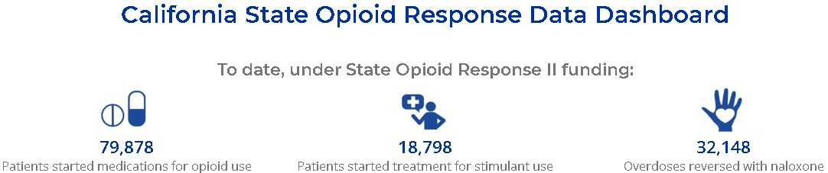
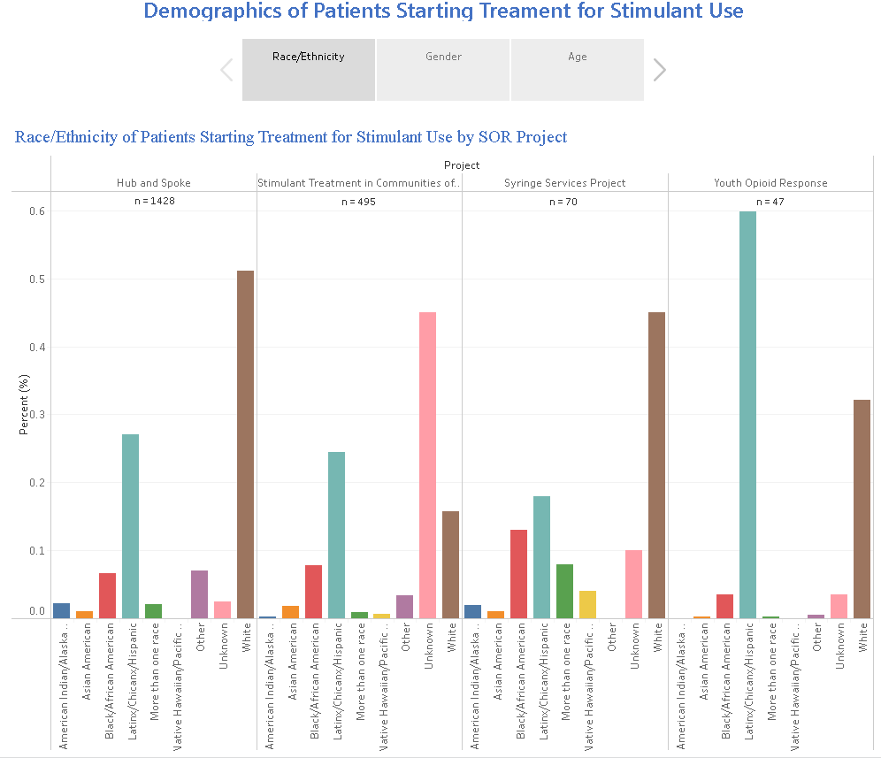
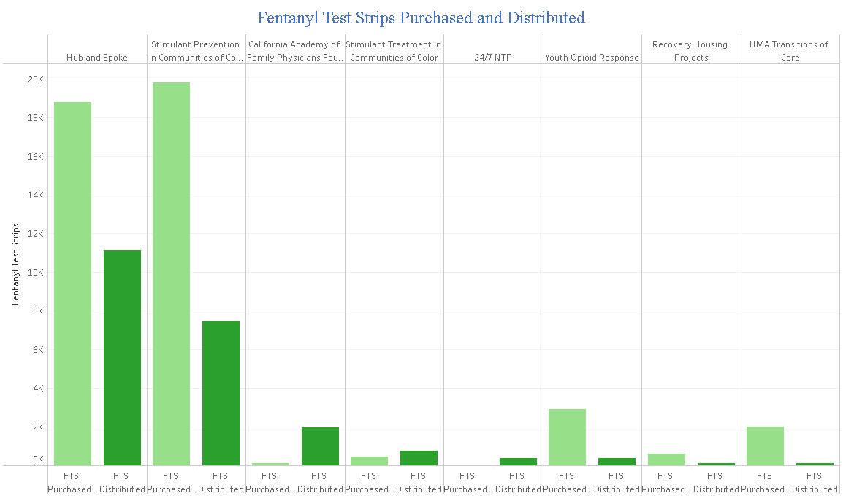
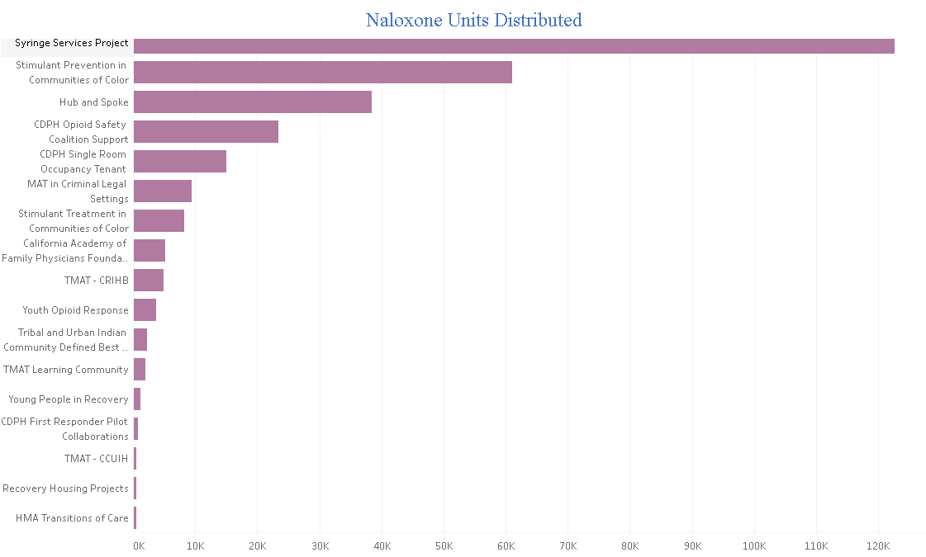
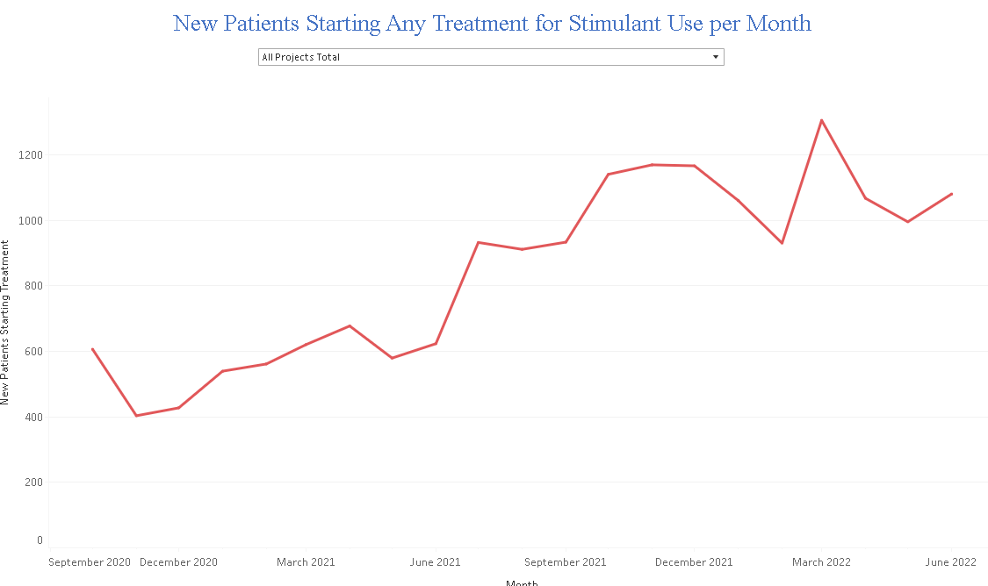
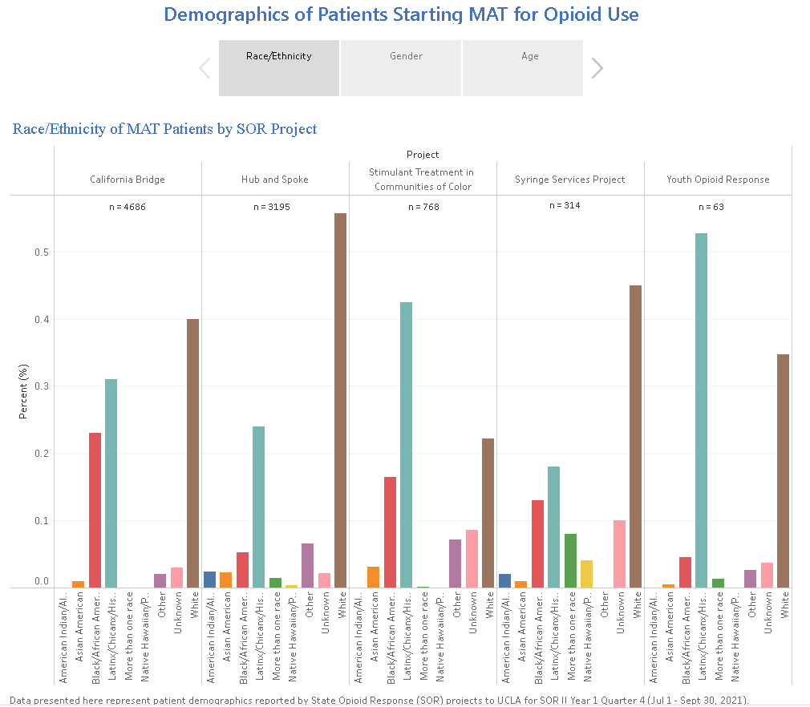
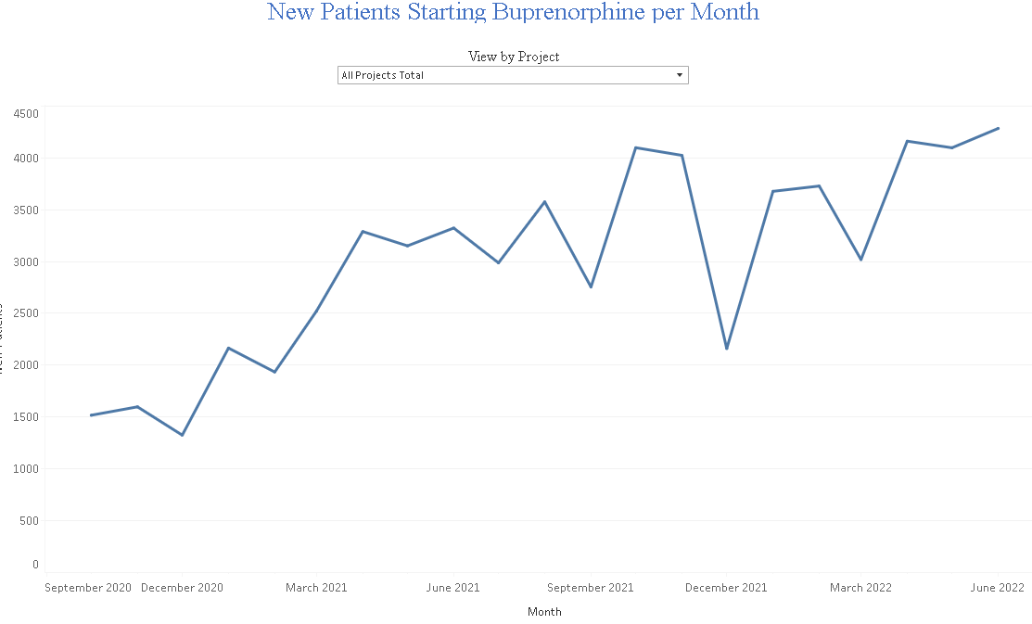
Dashboard (SOR II Dashboard as an example)
https://uclaisap.org/sor-eval/html/dashboard.html
Coming soon: New Dashboard for SOR III + other projects, data briefs, MAT Expansion Impact Analysis
.
Notes:
These are taken from an existing but soon-to-retire dashboard for SOR II, which recently ended. SOR II was just one piece of DHCS’s activities over a 2-year period.
When you add this to SOR II’s predecessors (34.595 new patients in H&SS 2017-2020), over 100k people have received treatment. About 300k naloxone, over 22k Fentanyl Test Strips distributed. Some limitations and caveats about the data but they don’t detract from the conclusion that it’s a big number.
MAT Expansion Impact Analysis: Intent is to answer what the individual and aggregate impact has been of the MAT expansion projects. What would it have looked like if the projects didn’t exist?
Reports: https://www.uclaisap.org/ca-hubandspoke/html/reports.html https://www.uclaisap.org/dmc-ods-eval/html/reports-presentations.html

Slide 41
What Should be Next?
Continue or expand: Medications, contingency management, Naloxone Distribution Program, fentanyl test strips, education.
Take advantage of buprenorphine X-waiver requirement removal
Measure & eliminate disparities
Expand beyond the walls of SUD programs, integrate with harm reduction, primary care, mental health, jails. Methadone outside of NTPs, field & community-based services.
Address short-term funding challenges
Youth prevention
Lower barriers to getting treatment through Medi-Cal
Notes:
DMC penetration rate = 5% or about 55% of those who think they need treatment. Nationally usually around 10%. 95% of people who needed but did not receive treatment felt they did not need treatment according to NSDUH surveys.

Slide 42
Questions?
DURADA@MEDNET.UCLA.EDU

Slide 43
For reference: Treatment Admissions since 1992
Notes:
MAT expansion has focused on expansion outside of specialty care (spokes, ED, etc)

