Slide 1
The Vulva and Vagina in Menopause
Tami Serene Rowen MD MS
Associate Professor
University of California, San Francisco
Obstetrics, Gynecology and Reproductive Sciences

Slide 2
How Many Symptoms are we Talking About
Signs and symptoms of GSM
Urinary
Frequency
Urgency
Post-void pain
Dysuria (pain with urination)
Nocturia (urinating at night)
Hematuria (blood in urine)
Recurrent urinary tract infections
Prominence of urethral meatus
Genital
Dryness
Imitation/Burning/Itching of vulva and vagina
Bothersome discharge
Erythema
Tissue fragility/fissures/petechiae
Decreased vaginal moisture/elasticity
Labial shrinkage/labial fusion
Loss of vaginal rugae (folds)
Clitoral hood retraction
Vaginal stenosis and shortening
Sexual
Decreased lubrication with sexual activity
Dyspareunia
Post-coital bleeding
Decreased arousal/orgasm/desire
Hypertonic pelvic floor
Pelvic pain

Slide 3
Vaginal Symptoms and Menopause
Genitourinary Syndrome of Menopause (GSM) previously known as vulvovaginal atrophy are present in upwards of 905 of women (ranges 39-90% in various studies)
Women in the United States have a higher rate of discomfort discussing with a provider
The symptoms associated with GSM can occur during any reproductive stage.
  Relative low estrogen states can occur in pre-menopausal women, altering circulating hormonal levels and microbiota.
Fewer than 10% of women with GSM symptoms use prescribed therapy; this disparity between prevalence and treatment can be attributed to a lack of patient and provider education and a failure to recognize symptoms.

Slide 4
Barriers to Treatment
Patient comfort discussing symptoms
Provider comfort asking about symptoms
Limited knowledge about treatment options
Concerns regarding safety of treatments
Classification of treatments as “lifestyle medications”
Cost barriers to treatment

Slide 5
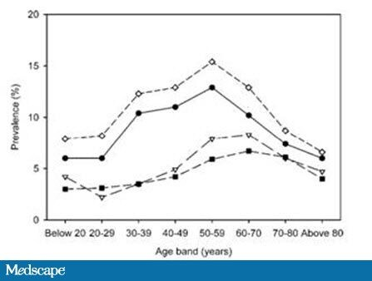
More on Sex: Its not just GSM!
Prevalence of sexual problems associated with sexually related personal distress by 10-year age bands.
Filled circle, desire; open triangle, arousal; filled square, orgasm; open diamond, any.
From Shifren JL, Monz BU, Russo PA, Segreti A, Johannes CB. Sexual problems and distress in United States women: prevalence and correlates. Obstet Gynecol. 2008;112(5):970-97

Slide 6
Limitations of Current Treatments
For sexual desire FDA approved meds are ONLY for premenopausal women
  Approval for postmenopausal women involves treating psychotropic same as hormone therapies
Many women seek off label medications, especially Testosterone, which is not approved for women but has significant evidence for use
The lack of an approved product leads many to seek care with people who do not follow any known guidelines on prescriptions and expose patients to harm

Slide 7
Recommendations
Consider importance of approval of variety of FDA approved medications for GSM
  Local vaginal hormones, including estradiol and prasterone
  Medications that can be taken orally
    Ideal for patients with severe trauma and or pain
Coverage for perimenopausal women to access FDA approved medications for low desire
Regulation and oversight for off label use of hormones, focusing on role of professional guidelines for off label use

