Slide 1
The 21st Century Healthcare Workforce
The Pharmacist as the Team’s Medication Expert
R. Pete Vanderveen, PhD, RPh
Dean, School of Pharmacy

Slide 2
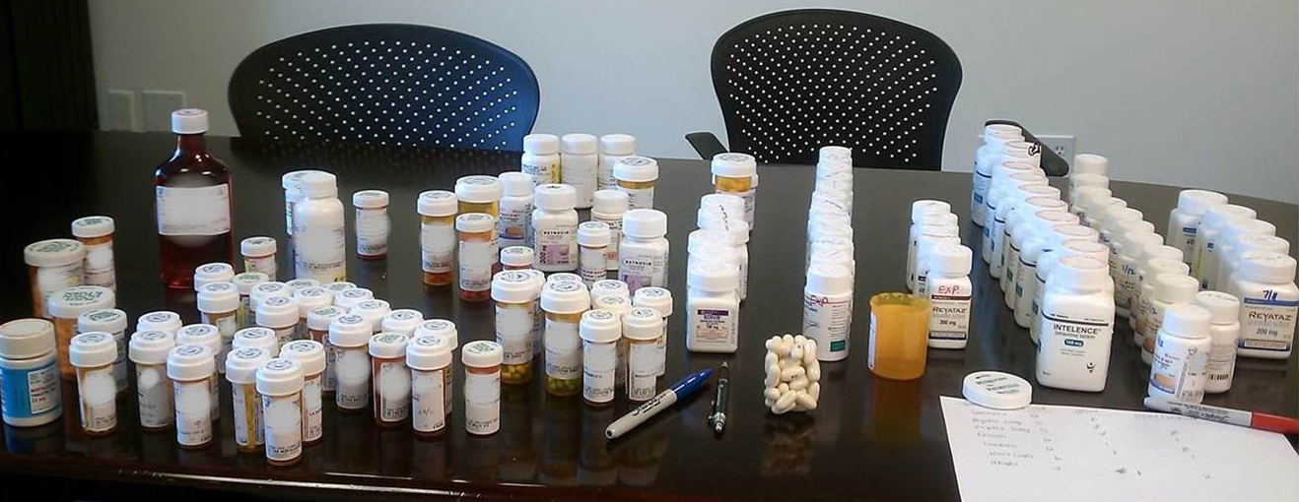
NEW HIV PATIENT brings meds to clinic…
92 Drugs
56 Unopened (valued at $48,000)
Automatic refills with no oversight
Patient missing therapeutic goals, tens of thousands of wasted $
WE CAN DO BETTER THAN THIS.

Slide 3
The Problem:
30+ million newly insured require access
By 2025, Association of the American Medical Colleges predicts a shortage of 150,000 primary care physicians
Healthcare costs are tracking toward a 19.3% of GDP by 2019….unsustainable and threatening the nation
Goalpost: US Government aims to pay for outcomes and safety…not for procedures….and evidence-based, coordinated care
Pharmacists are the most accessible and underused health professional
PharmD requires 4 years of post-graduate education focusing on medication therapy
Nearly 2,000 hours of required clinical training
Healthcare team’s most knowledgeable member of the most frequent first-line of treatment – medications

Slide 4
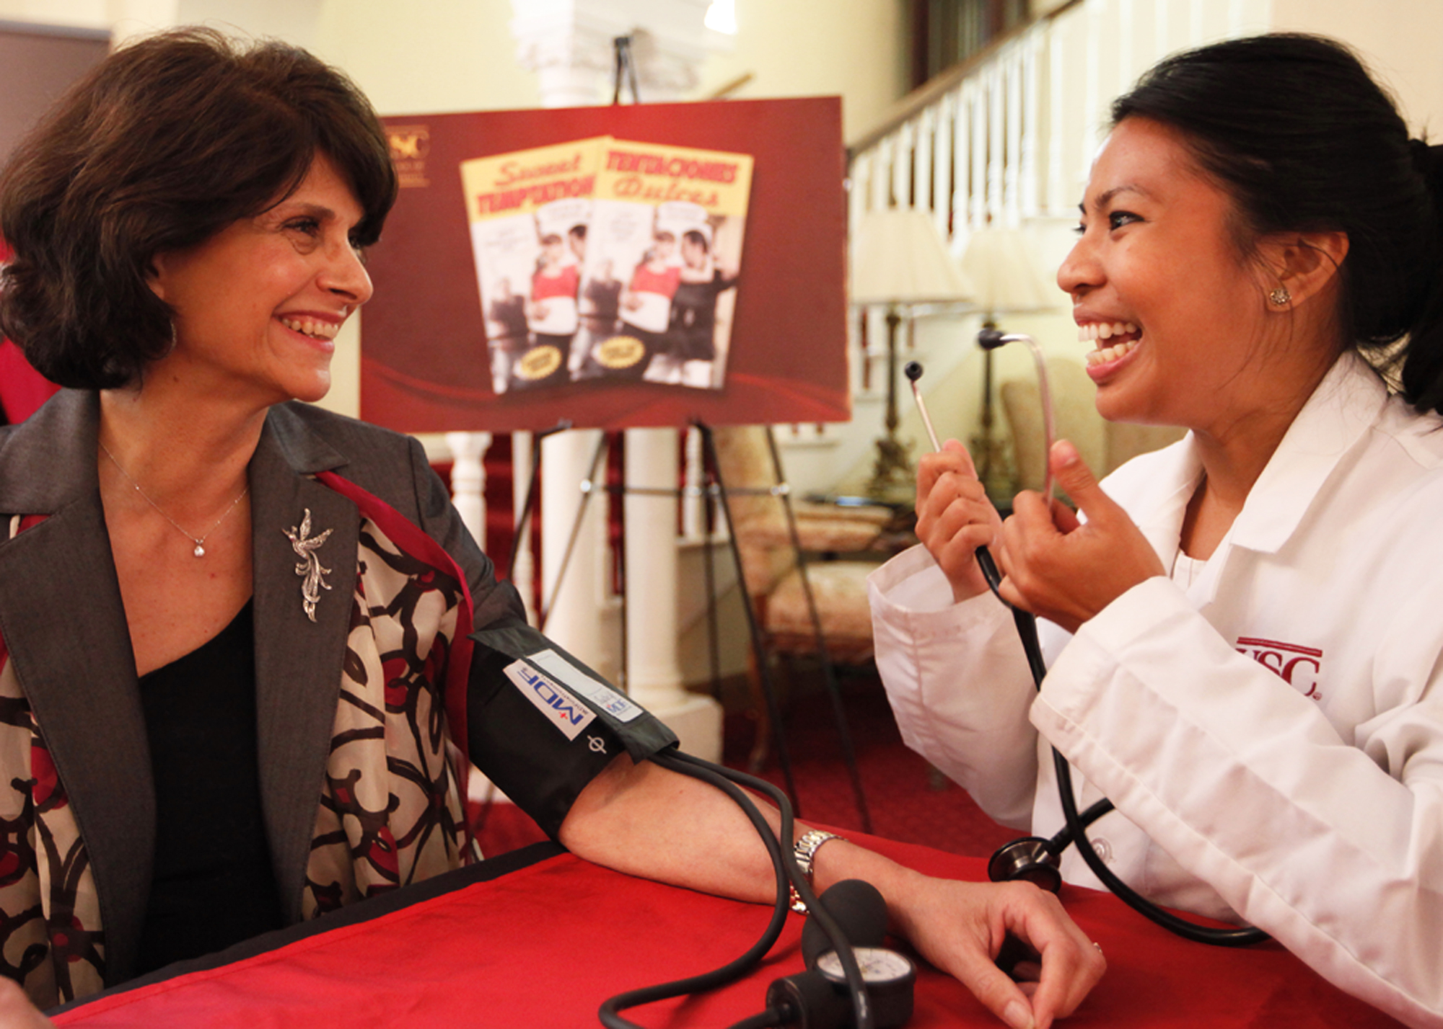
FIRST, DO NO HARM
1.5 million people injured annually due to medications
$310 billion spent on meds…$290 billion spent treating problems created by meds
90% of chronic illnesses require medication as first-line therapy
(Institute of Medicine, To Err is Human)
….BUT THE PHARMACIST DOES NOT HAVE PROVIDER STATUS, SO SHE CANNOT DO THE MEDICATION MANAGEMENT THAT IS REQUIRED FOR OPTIMAL RESULTS

Slide 5

Who Benefits Most from Clinical Pharmacy Services/Medication Therapy Management?
Patients
  Multiple medications
  Multiple chronic disease states
  Multiple prescribers
  Meds requiring frequent monitoring/dose adjustments
  Geriatric patients
  Patients recently released from hospitals
  Underserved
….and those paying the bills….

Slide 6
Clinical Pharmacy Services – Pharmacist Roles in Healthcare
Building clinical pharmacy services into the delivery system
Coordinated Care Programs
Prevention
Retrospective Drug Utilization Review
Discrete Service Components
Medication Access Services to Patients
Medication Therapy Management (MTM)
Disease State Management
Prospective Chart Review
Provider Consultation
Patient Counseling
Drug Information
Medication Reconciliation
Provider Education
Clinical Review Services
Clinical pharmacy services packaged for delivery & reimbursement.

Slide 7
CA LEGISLATURE IS PROGRESSIVE….MAKING US A NATIONAL LEADER
Collaborative practice laws
Laws allow pharmacists to immunize
Allowing USC to implement clinical pharmacy service in 12 safety-net clinics…

Slide 8
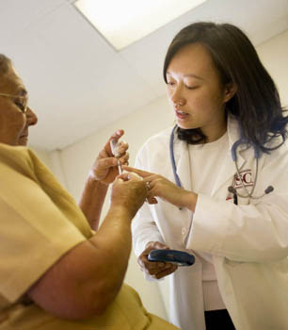
USC-Affiliated Safety-Net Clinics
3 to 12 sites in 7 years
CCH (JWCH)
QueensCare – 4 sites
MCA
LACHC
Altadena barbers
Clinicas Del Camino Real – 4 sites
Aim to expand to 24 sites by 2013

Slide 9
Return on Investment – Snapshot from Our Clinics
Clinical Outcomes…when a Pharmacist is Involved
Diabetes: Reduced A1C of patients by 3.7%
Blood Pressure: Reduced SBP by 26 mmHg; Reduced DBP by12 mmHg
Medication Cost Savings (1 FTE pharmacist serving 3 clinics)
Saved >$700,000 in annual medication costs
Increased access to critical medications previously unavailable in clinic
Increased Access to Medical Care
Initially Pharmacists were Funded by Grants → Funded by Clinics
“We are able to provide a wider range of services to a greater number of patients
due to the assistance of the USC School of Pharmacy….Our disease management indicators
have improved dramatically as a result of the assistance from the USC Pharmacy clinicians.” Paul Gregerson, MD, MPH, chief medical officer, JWCH
We are one of many nationally to have shown these results…others Asheville,
Kaiser, VA, name a company….

Slide 10
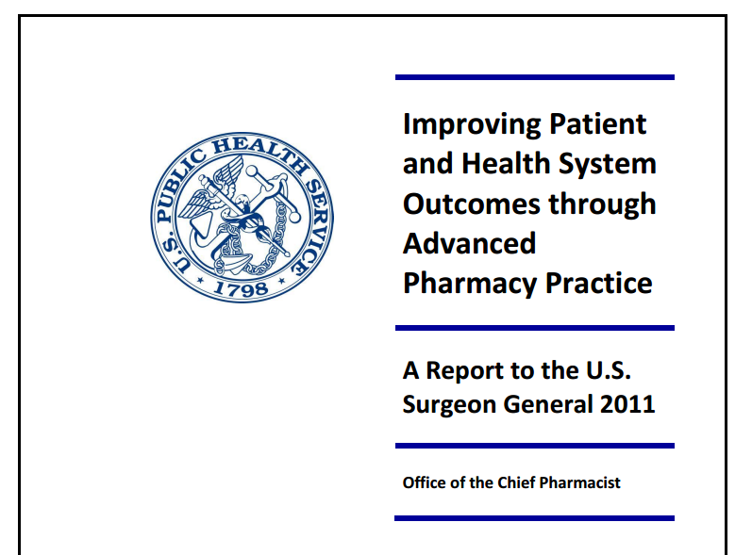
“…for each dollar invested in the clinical pharmacy service over the period from 1988 to 2005 (nearly two decades), the overall average benefit gained was $10.07 per $1 of allocated funds.”

Slide 11
How do Pharmacists Do This?
A study at one of our safety net clinics, showed that we:

Slide 12
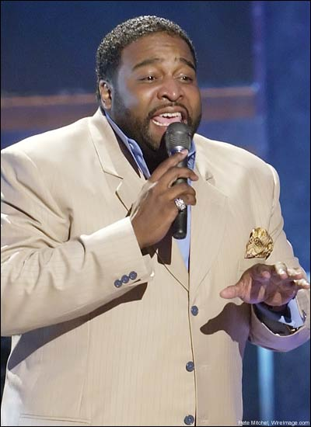

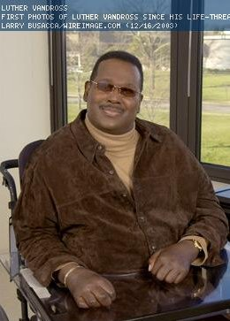


Gerald LeVert
Heart Attack, age 40
Barry White
Kidney Failure, age 59
ALL DIED YOUNG FROM COMPLICATIONS OF UNCONTROLLED HIGH BLOOD PRESSURE.
Luther Vandross
Stroke, age 54
Rick James
Heart Failure, age 56

Slide 13
Medications cause an unacceptable level of harm, death,
  and suboptimal results.
Pharmacists are the most underutilized healthcare professional.
Physician-pharmacist collaborations have been active for 50 yrs in settings where cost and quality are tracked, showing:
  ↑ Healthcare quality, medication safety, physician access, physician and patient satisfaction
  ↓ Total healthcare costs
  Support from HRSA, CMS, USPHS, VA, Kaiser…
Pharmacists are not recognized as healthcare providers.
Making pharmacists providers will save $, improve health outcomes and increase access…win:win:win.

Slide 14
21st Team Approach to Healthcare
Interprofessional education initiatives now required by all health-professional-school accrediting bodies
Scope of practice – expanding scope based on professional qualifications
Expanding scope to meet needs of patient population
Each professional to function at the highest level of their professional
Need to Address
System must provide HIT access to HC team (full patient record)
  Encourage Cal eConnect (CA Health Information Exchange) to transact with pharmacists beyond Rx data
Statewide protocol that allows pharmacist to have full participation for immunization
Revise restrictive CLIA regulations limit pharmacists’ full participation in pharmacy-based outreach to the underserved through health screenings
Recognizing pharmacists as providers, opens residency funding from federal government
Physicians, Nurse Practitioners, Physician Assistants, Optometrists
All recognized as providers….but pharmacists are not
Yet pharmacists are the most accessible and best prepared to manage medications.

