Slide 1

Family Medicine Accelerated Track:
Experiences in Implementing a 3-Year Medical Degree
Ronald L. Cook, DO, MBA, FAAFP
Betsy Goebel Jones, EdD
Department of Family &
Community Medicine
TTUHSC Lubbock

Slide 2
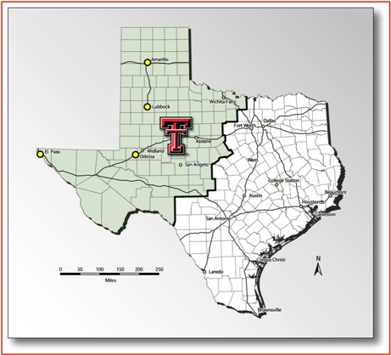
What is the
Family Medicine Accelerated Track?
A 6-year program designed to increase the number of family physicians, more efficiently and at less cost
3-year accelerated medical school curriculum resulting in the MD degree
Guaranteed residency position in Family Medicine in Amarillo, Lubbock or the Permian Basin

Slide 3
How F-MAT Works
Three years of medical school rather than four
151 weeks of instruction vs. 160 in the 4-year curriculum
One less year of tuition & fees
One year of scholarship for the MS2 year provided by TTUHSC School of Medicine
  $7750 in July (covering F-MAT1 & the fall semester)
  $7750 in December (covering the spring semester)

Slide 4
American College of Physicians, 2008
Why F-MAT?
Without primary care, the health care system will become increasingly fragmented and inefficient, leading to poorer quality care at higher costs.
Better Care

Slide 5
Kaiser Family Foundation, 2011
Why F-MAT?
A higher ratio of specialists to population has been correlated with higher mortality rates while a higher ratio of primary care physicians to population is better for health.
Better Health

Slide 6
Robert Graham Center, 2011
Why F-MAT?
Adding one FP per 1,000 population, or 100 per 100,000 reduces readmission odds for pneumonia, heart attack, and heart failure by 7%, 5%, and 8%, respectively.
Lower Cost

Slide 7
Why Family Medicine in F-MAT?
Notes:
-Widely recognized future shortage of primary care physicians with continued declining student interest
-Approximately 20-25% of internal medicine graduates choose primary care careers
-Approximately 40% of pediatric graduates choose primary care careers
-Of Family Medicine graduates more than 90% remain in primary care and almost 40% do so in communities <25,000 or low income areas

Slide 8

How F-MAT
Addresses the Problems
One less year of tuition and fees
One year scholarship of $15,500.00 (2012-13)
  $7,750 tuition scholarship for MS2 Fall
  $7,750 tuition scholarship for MS2 Spring
Decreasing medical school by one year offers greatest potential to reduce financial burden $160,000-$230,000
Earlier clinical experiences
FM Faculty : Student ratio of 1:2

Slide 9


Program Approval
ACGME proposal for Program Experimentation & Innovation Project
LCME proposal for Program Variation
February 2010: LCME “voted to receive the report and requested additional information about the process and outcomes of this accelerated educational track after implementation” with a status report by August 15, 2013.

Slide 10
F-MAT Program at TTUHSC
Key Details
Class size: up to 12 students (out of 145-student class size)
Year-round training for 3 years
  MS1 & MS2 years are unchanged
  Longitudinal FM clerkship in MS2 year
  MS3 year incudes 5 clerkships + capstone course
  No MS4 year
Linked to FM residency programs in Lubbock, Amarillo & the Permian Basin
  Students/residents ideally distributed so that F-MAT students don’t exceed ½ of the residency class
Sources of support: HRSA Predoctoral grant, Dean’s office scholarship funds, high-profile institutional priority

Slide 11
F-MAT Curriculum

Slide 12
F-MAT Student Selection
Classes of 2013 & 2014
Class of 2015
Selected from MS1 class
Advantages: Students’ academic abilities & aptitudes are tested
Disadvantages: Applicant pool is limited to current students
Selected from MS1 class and from students applying from medical school
TMDSAS & Secondary App + additional interview
“Special Program” allows for early acceptance
We are currently seating both the
Class of 2014 & the Class of 2015

Slide 13
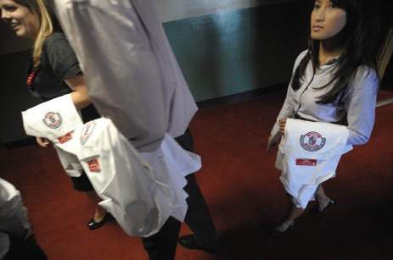
F-MAT Recruitment 2011-2012
During SOM Admissions Process
Process for Class of 2015
Interest in F-MAT added to TMDSAS & Texas Tech Secondary Applications
Students had a 3rd interview with a family medicine/FMAT faculty member
FMAT faculty members (FM & basic sciences) met to review and rank applications
Early offers were extended to 6 students

Slide 14
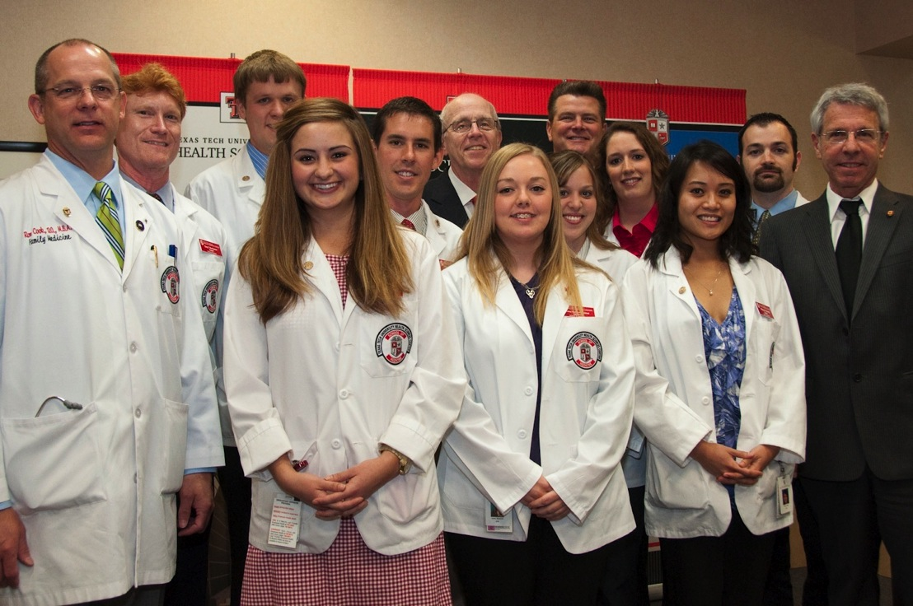
F-MAT Student Perspective

Slide 15
F-MAT Students Surveying
F-MAT Students
As of November 2011

Slide 16
F-MAT Students Surveying
F-MAT Students
As of November 2011

Slide 17
Has F-MAT Changed your perceptions of Family Medicine?
As of November 2011
FMAT has reinforced my confidence that FM is the right field for me. The spontaneity and variety within the field: from delivering babies, to taking care of the elderly and everything in between has always been enticing to me, and being active in FMAT has made it clear to me that this variety is the definition of family medicine.
I have gotten much more exposure to FM, especially in the areas of handling OB patients and in patient care. I feel like I have a much better understanding of the depth and breadth of care FM offers, and am even more “in love” with the specialty than I was with small exposure I had had before.

Slide 18
How are you feeling right now as you are trying to complete the FM clerkship & neuro?
As of November 2011
It’s tough to juggle the clerkship & neuro right now, I won’t lie– but I’m grateful for and enjoy the early clinical exposure. I know it was pay off in the end.
Right now is the most stressful time I’ve experienced in medical school… I have noticed a definite decrease in my test grades, but this might be due simply to the fact that neuro is a harder course. All of this being said, however, I would not trade the clinic time. Clinic is interesting, exciting and will be 100% relevant to my future as a family physician. The same cannot necessarily be said for neuro.

Slide 19
What advice would you give current MS1s who might be contemplating doing F-MAT?
As of November 2011
Keep your eyes open, make sure that FM is really what you want to do for the rest of your life, be prepared to be busier than your classmates and have to develop clinical skills faster, and enjoy the fun you will have in your time in clinic and on the (hospital) service.
If you are already thinking about entering into FM, this is the premier program for you. It will allow you to graduate sooner and leave with a significantly lower amount of debt.

Slide 21

F-MAT Risks & Barriers
Faculty-intensive
Requires full administrative support and FM faculty buy-in
Student scholarship support
Fast-paced curriculum may eliminate students and discourage them from FM career
Loss of student commitment to FM over time (traditional 4 year student)
Students must go through the NRMP match and may choose to rank residency programs outside of TTUSOM
Notes:
Students will be monitored closely and if determined to be at risk or actually fail – will be eliminated from FMAT
They may change their minds and opt out of FM in favor of another specialty – need to carefully select students
Would be difficult to complete accelerated program and find time to interview for outside programs

Slide 22

What We’ve Learned
Give students plenty of time to think about applying
Be sure that students & faculty see evidence of institutional support
Involve the residency faculty in student recruitment & selection
Link the student selection process to the SOM admissions process
Accommodate students’ concern with Step exam prep

Slide 23
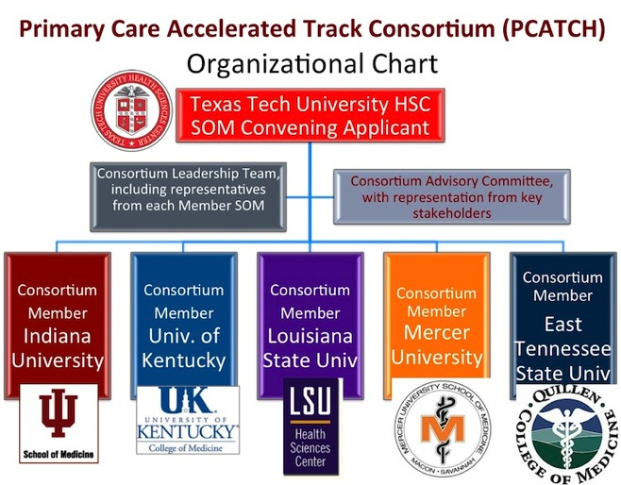
What’s Next?
Primary Care Accelerated Training Consortium (PATCH), with funding requested from CMMI?
  Potential consortium members: Mercer, Kentucky, LSU, Indiana, East Tennessee + TTUHSC
Additional financial support for MS2 and MS3 years?

Slide 24
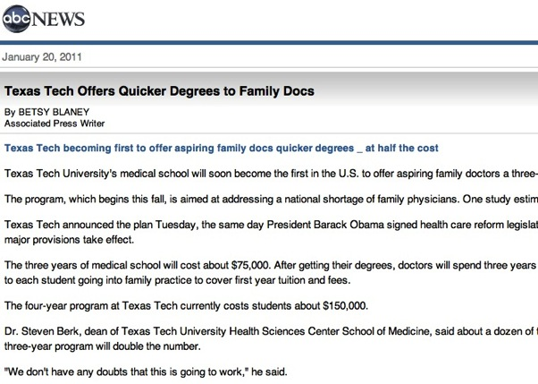
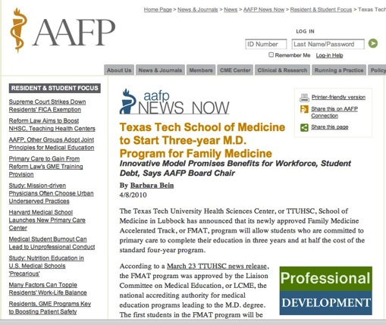
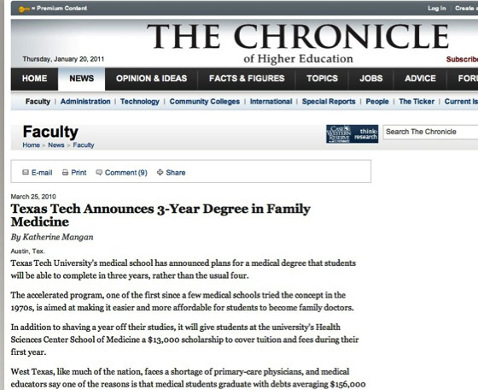
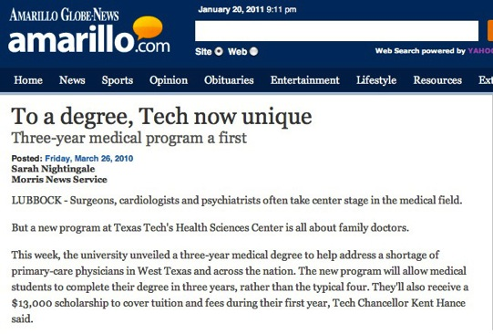

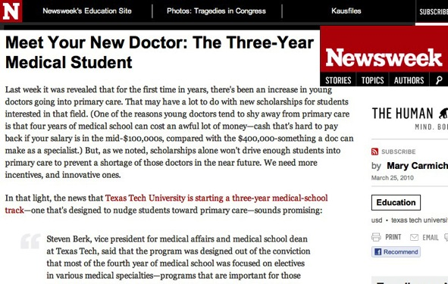
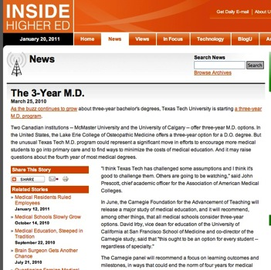
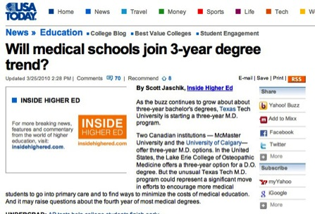
F-MAT Media Attention

Slide 25
Council on Graduate Medical Education (COGME), 2010
Why F-MAT?
Policies and programs should be implemented to enhance and support the practice of primary care, and to increase the supply of primary care physicians… Policy changes should be dramatic to remedy these legacy biases and have immediate effect
A New Model

Slide 26
http://www.ttuhsc.edu/som/fammed/

