Slide 1
Long COVID in Adults
Post-acute Sequalae of SARS-CoV-2 Infection (PASC)
Steven Deeks, MD Professor of Medicine
University of California, San Francisco

Slide 2
Social media and advocacy groups drove the agenda in 2020-2021
First reports: Social media
Early 2020
Press Coverage
Summer 2020
Advocacy Groups Form
Mid-2020
US Congress
April 2021

Slide 3
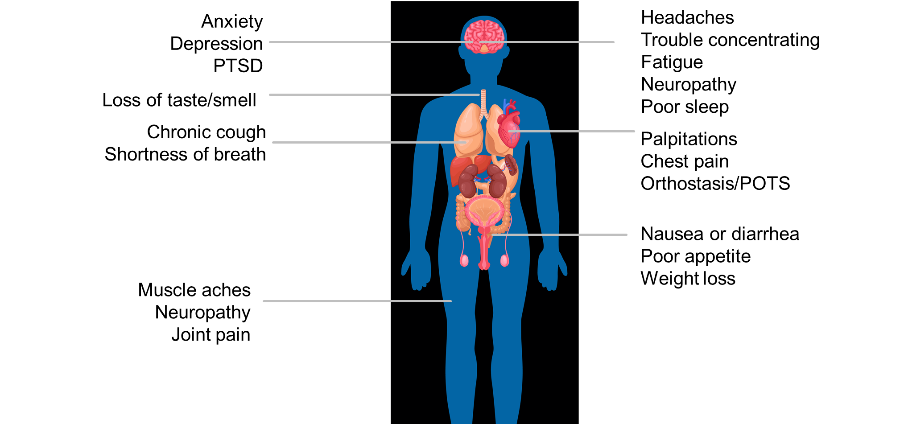
Long COVID Multiple names: PASC, PACS, Post-COVID Syndrome, Long Haulers
WHO: New symptoms that affect everyday function, emerge within 3 months of the infection, and last for at least 2 months; symptoms may fluctuate over time
Notes:
WHO: Post COVID-19 condition occurs in individuals with a history of probable or confirmed SARS-CoV-2 infection, usually 3 months from the onset of COVID-19 with symptoms that last for at least 2 months and cannot be explained by an alternative diagnosis. Common symptoms include fatigue, shortness of breath, cognitive dysfunction but also others and generally have an impact on everyday functioning. Symptoms may be new onset following initial recovery from an acute COVID-19 episode or persist from the initial illness. Symptoms may also fluctuate or relapse over time.

Slide 4
Major issues
How should we define Long COVID?
Who is most at risk?
What is the natural history?
Will vaccination post-infection prevent or reverse Long COVID?
Will antiviral therapies during acute infection prevent Long COVID?
Will Omicron infection lead to Long COVID?
What is the mechanism?
How should Long COVID be managed
Novel therapeutics
Centers of Excellence (Long COVID clinics)

