Slide 1
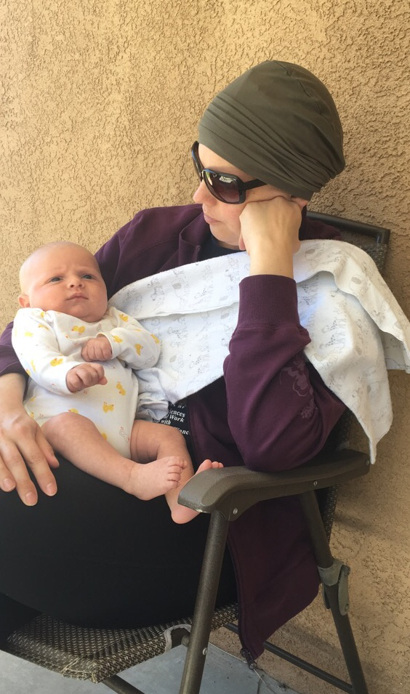
CA Senate Informational Hearing on Menopause
Katrina Mitchell, MD, IBCLC, PMH-C
Breast Surgical Oncologist, Lactation Consultant,
Perinatal Mental Health Provider
Ridley-Tree Cancer Center
Santa Barbara, CA

Slide 2
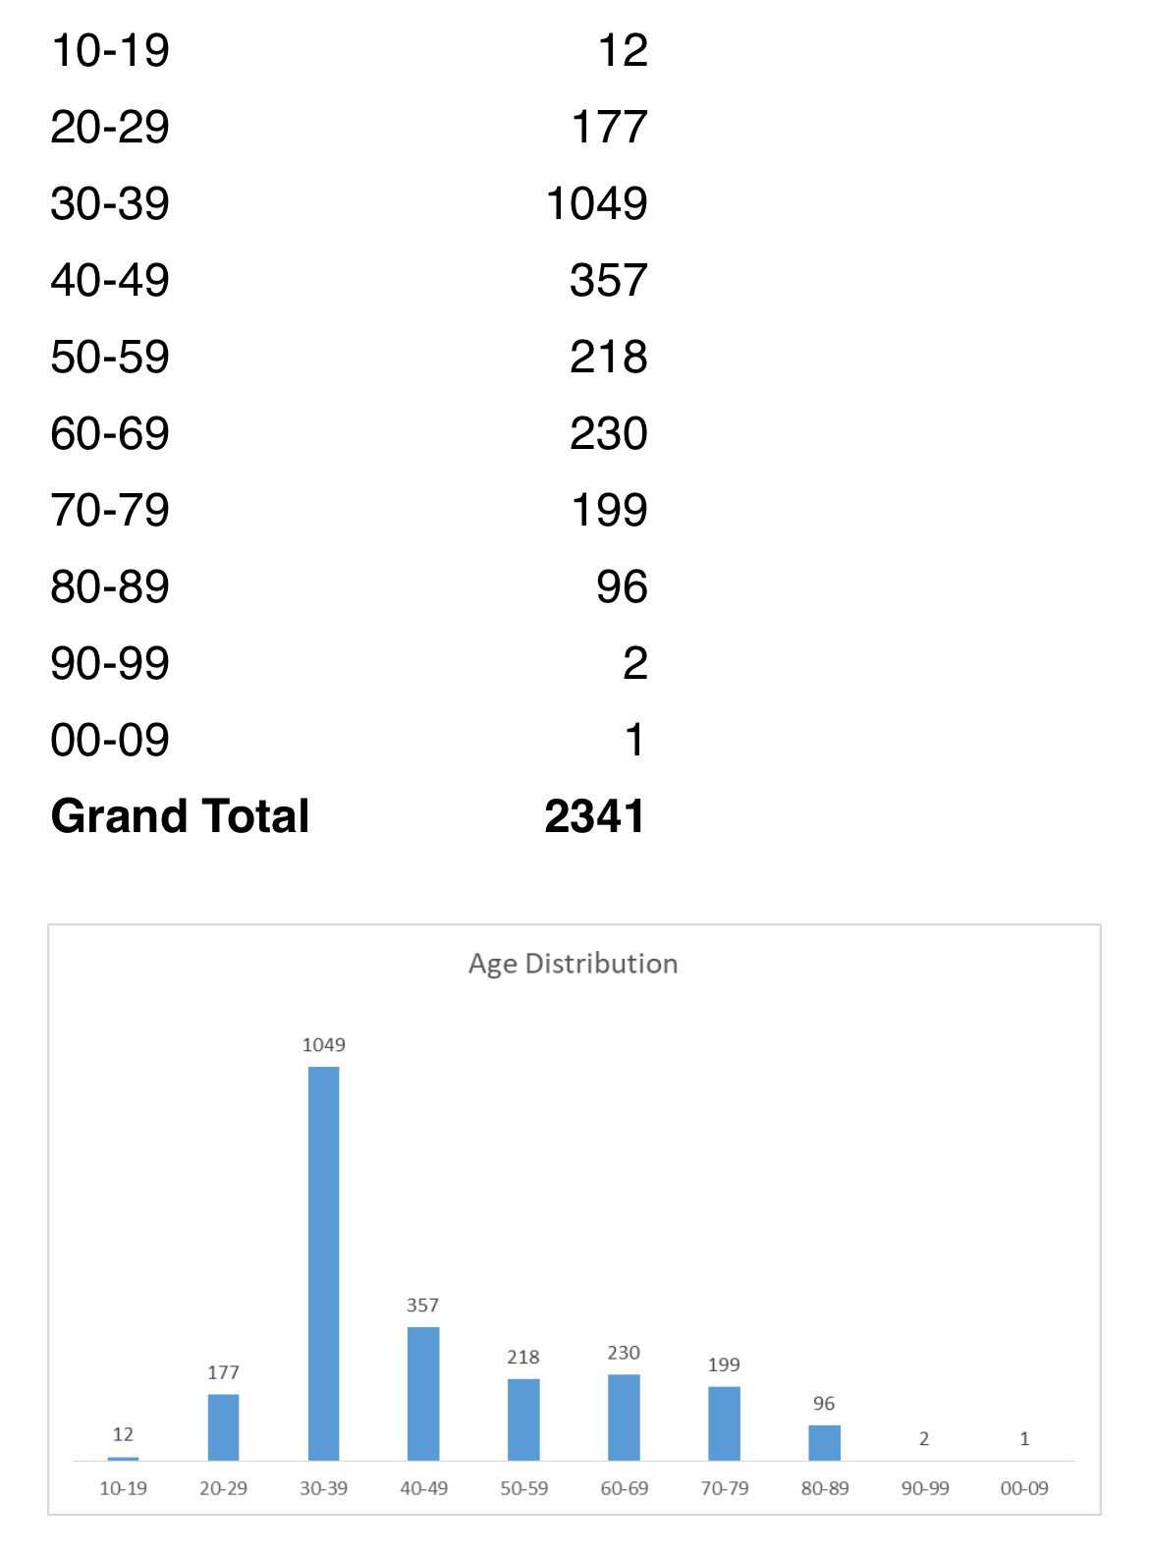
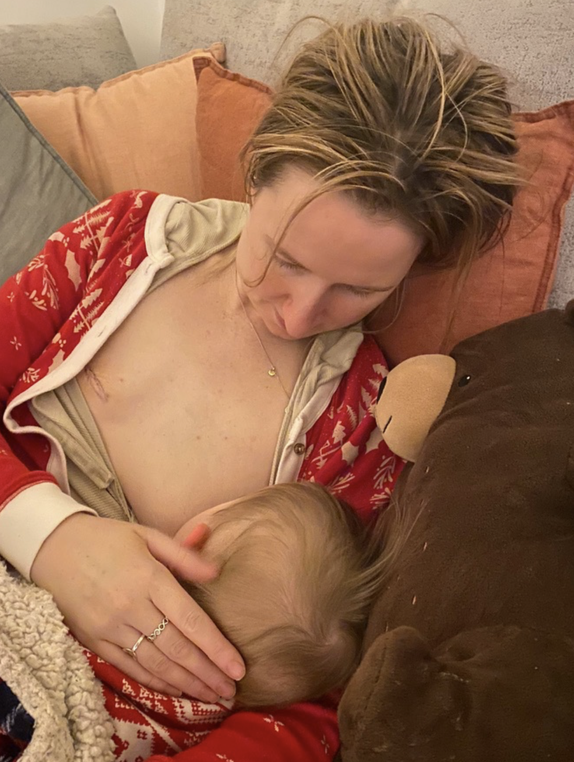
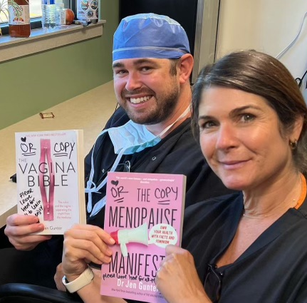
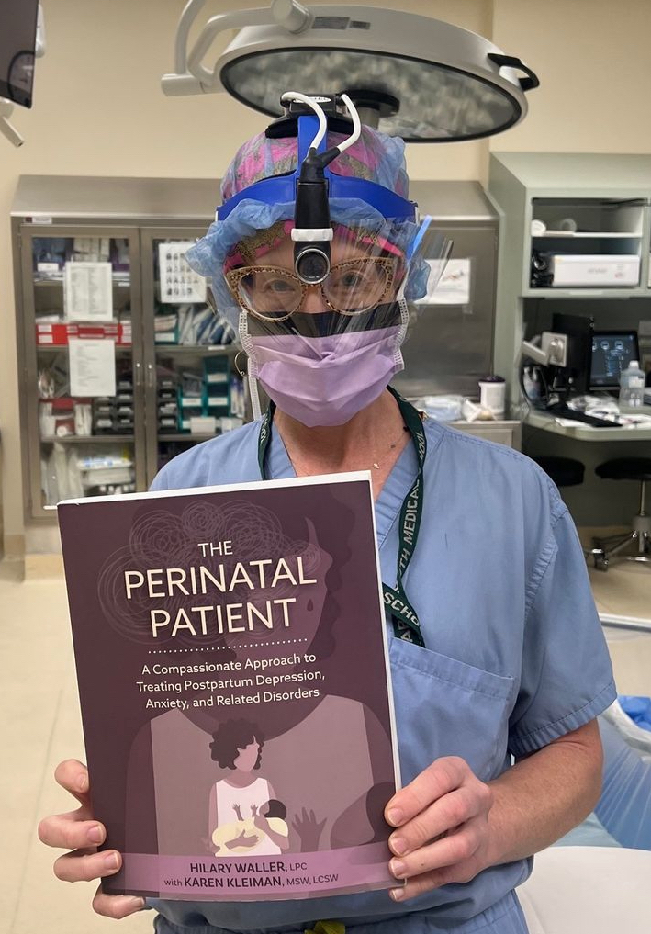
My Patient Population: Women at Times of Hormonal/Life Change

Slide 3

With very few exceptions, breast cancer patients will receive chemotherapy and/or endocrine therapy that results in premature menopause or worsening of existing symptoms
Vaginal dryness, urinary symptoms
Joint pain
Hair, skin, and nail changes
Libido, sexuality
Energy, cognition

Slide 4

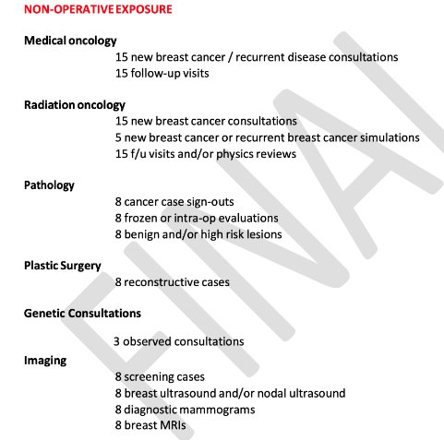

Slide 5
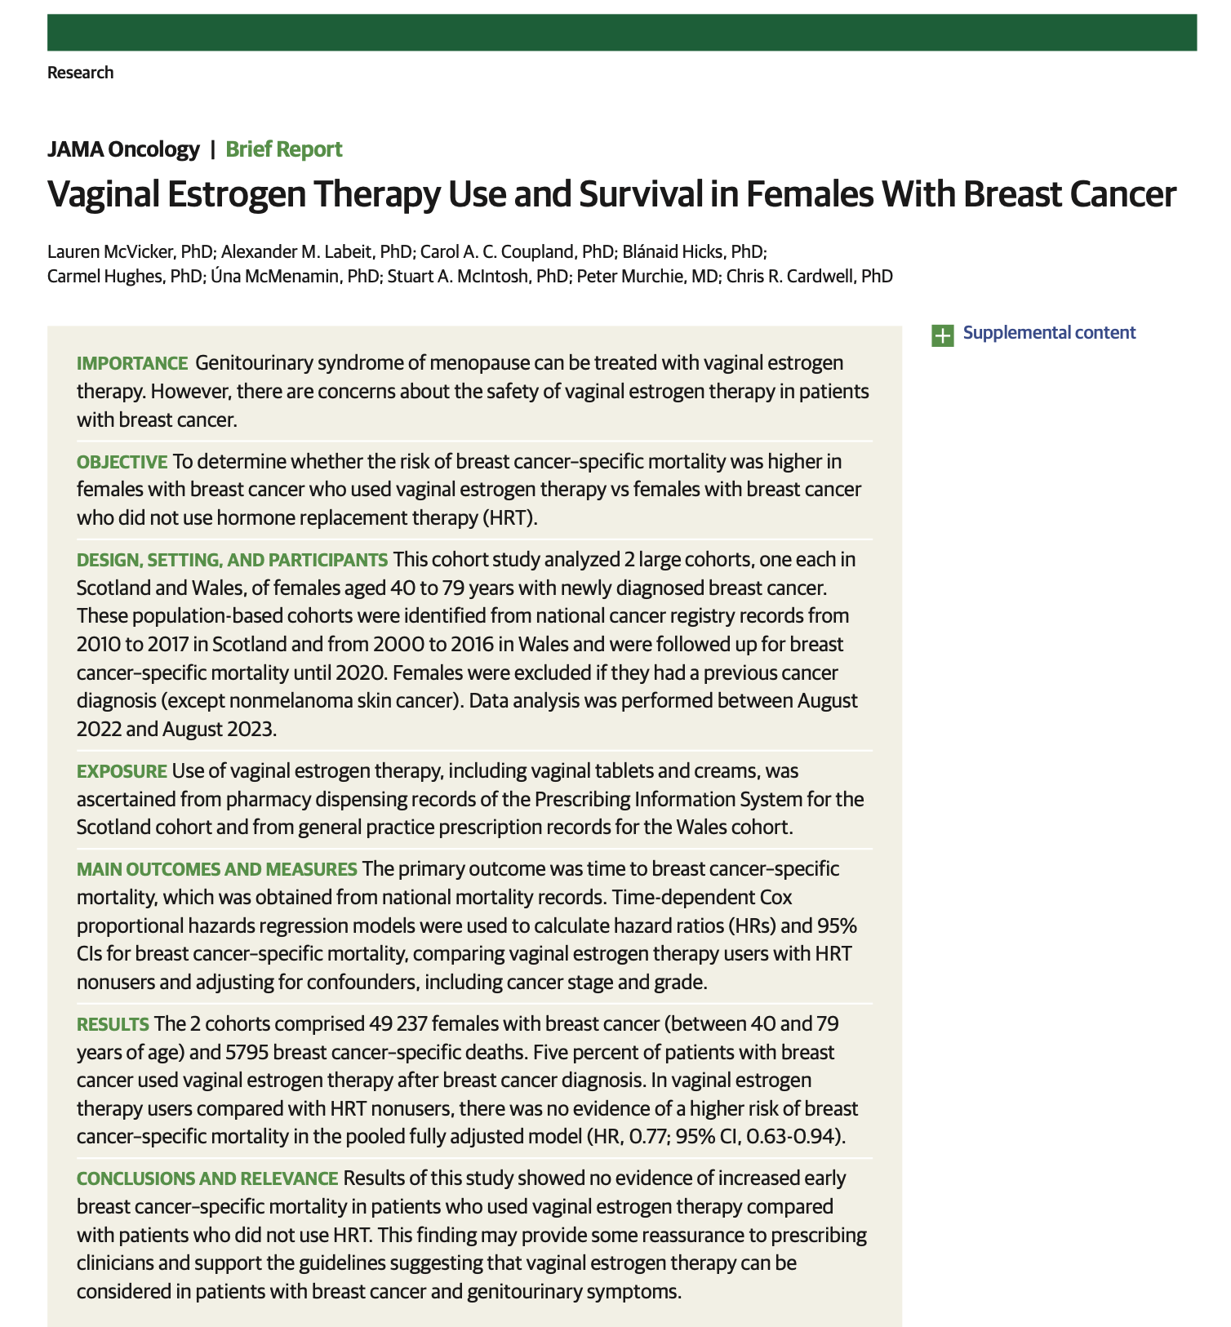
Breaking Oncology Myths

Slide 6
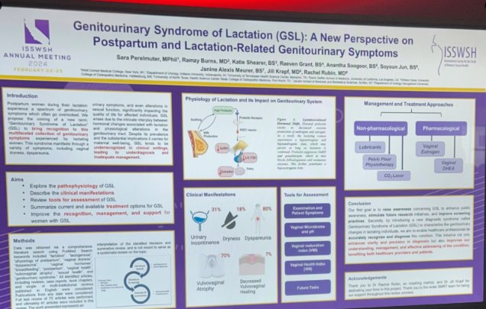

Slide 7
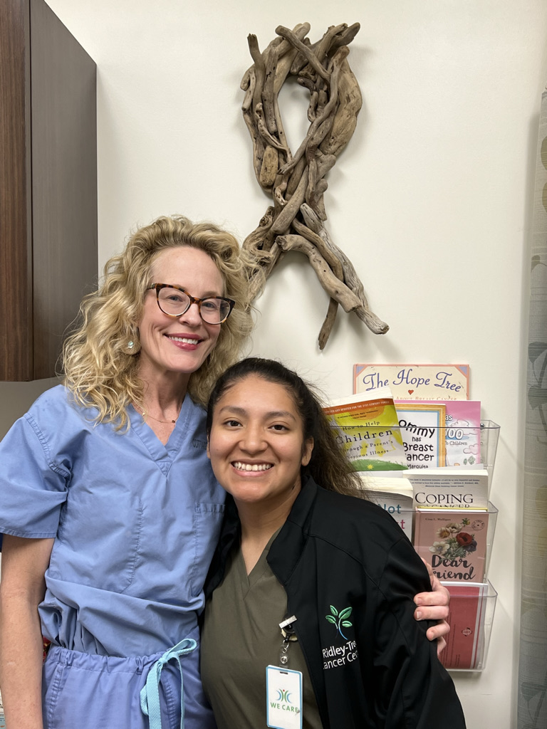
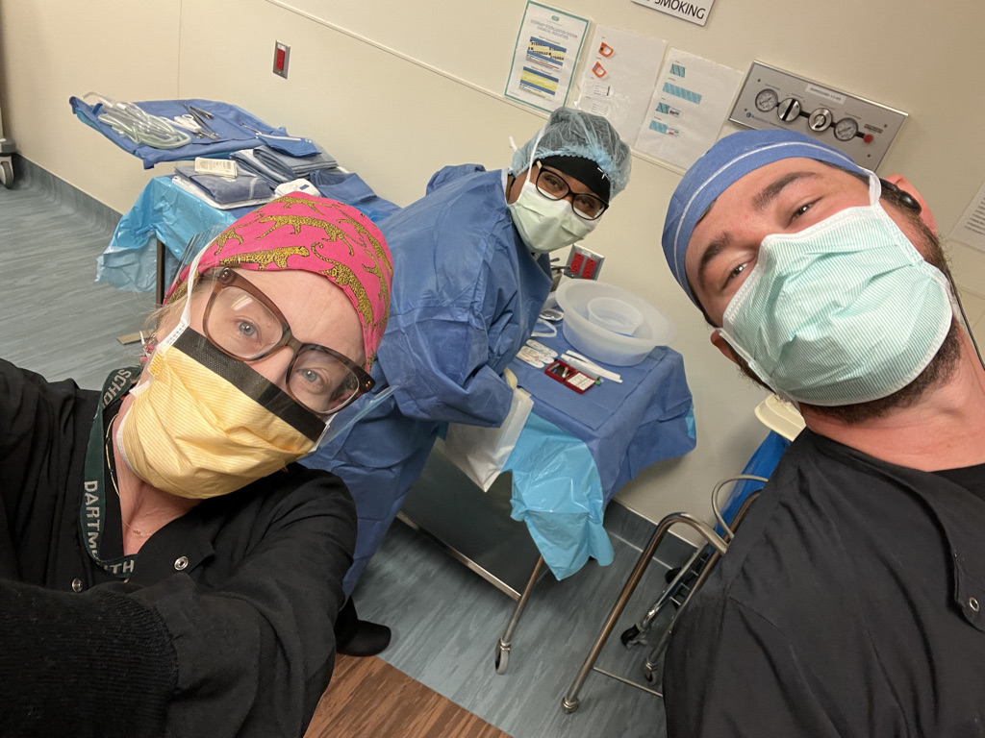
Diversifying Physician/Provider Workforce
¾ of medical school matriculants are from the top two household income quartiles

Slide 8
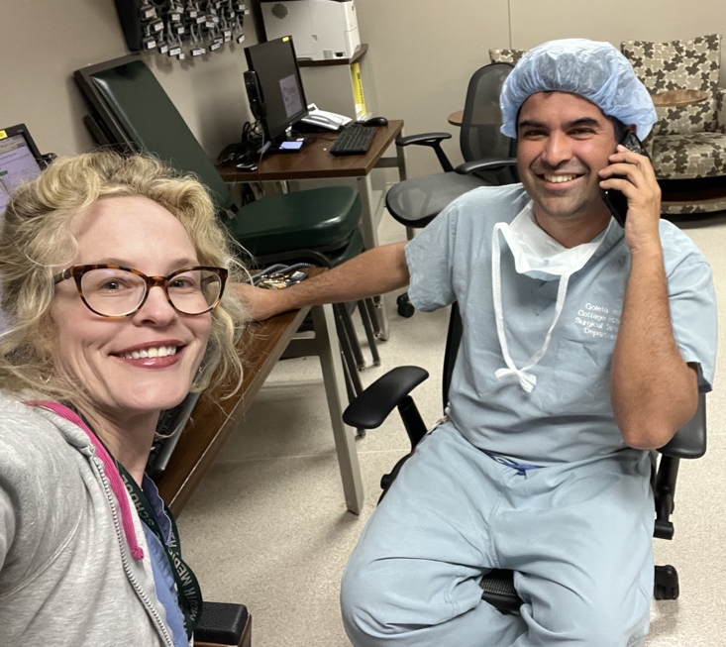
Sexuality/psychosocial impact of care
Insurances are required by law to cover reconstruction with breast cancer surgery, but the reimbursements are so poor that plastic surgeons in rural communities can’t afford to keep offering these services
Large hospital/facility fees and reduced payments to physicians
All = REDUCED ACCESS

Slide 9
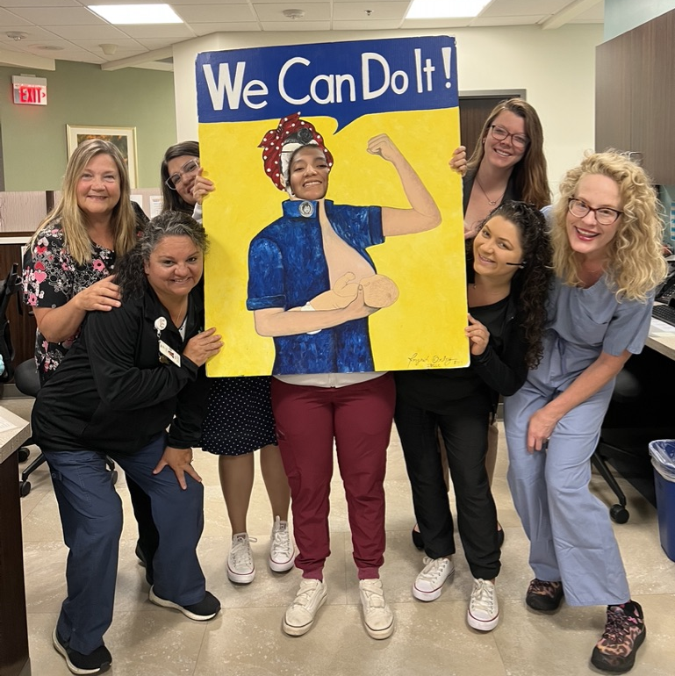
Take Home
Many specialties interact with patients at time of hormonal change and often have no education on the topic
Need for increased awareness regarding safety information for vaginal estrogen
COST of vaginal estrogen prohibitive
Impact of care not just hormonal – need to address access to care issues in breast reconstruction in rural communities
Katrina

Slide 10

Thank you!
KatrinaMitchell.Org

