Slide 1
Drug Medi-Cal Organized Delivery System Waiver Evaluation
Darren Urada, Ph.D., Cheryl Teruya, Ph.D., Valerie P. Antonini, M.P.H., Vandana Joshi, Ph.D., David Huang, Ph.D., Howard Padwa, Ph.D.,
Anne B. Lee, L.C.S.W., Elise Tran
UCLA Integrated Substance Abuse Programs
Senate Health Committee Informational Hearing
March 13, 2019
Support provided by DHCS.
All opinions expressed are those of Dr. Urada and do not necessarily represent those of UCLA or DHCS.

Slide 2
Drug Medi-Cal Organized Delivery System (DMC-ODS) Demonstration Waiver Goals (partial)
Provide access to treatment services not previously covered by DMC, and a full continuum of care.
Increase coordination of SUD services with physical and mental health services
Enhance counties’ ability to selectively contract with providers.

Slide 3
DMC-ODS Implementation
7 counties began in 2017 (today’s presentation focuses on these)
14 more began in 2018
33 have submitted implementation plans. 97% of CA popn.

Slide 4
After counties began waiver services, the # of people receiving treatment rose modestly
Notes:
Not so much a flipping of a switch as it was a ramp up. It’s a process.
Overall, increase is about 7%.

Slide 5
…but there was a large increase in people receiving residential treatment

Slide 6
Is that the right level of care? Placements match the level indicated by assessments (Three Counties)
Notes:
San Mateo, Santa Clara, Marin
Most referrals to indicated LOC, Where there was a mismatch, generally the patient was referred to a lower level of care than indicated. Most frequent reasons were missing data on the actual placement, clinical judgement, followed up by unavailability of the indicated level of care (all roughly 21-28%).

Slide 8
County Administrator Feedback on DMC-ODS
County administrators overwhelmingly report the waiver has positively influenced:
Establishing beneficiary access lines
Quality improvement activities
Communication between SUD and health, mental health services
Delivery of case management services

Slide 9
Challenges
Beneficiary access line “growing pains”
Expanding medical detox / withdrawal management
Transitions between levels of care
Room for improvement on penetration rates
Referrals from health care

Slide 10
Hub and Spoke Evaluation
Kendall Darfler, M.S., Darren Urada, Ph.D., Valerie Antonini, M.P.H., Howard Padwa, Ph.D., Vandana Joshi, Ph.D., and José Sandoval
UCLA Integrated Substance Abuse Programs
Senate Health Committee Informational Hearing
March 13, 2019
Support provided by DHCS.
All opinions expressed are those of Ms. Darfler and do not necessarily represent those of UCLA or DHCS.

Slide 11
Hub and Spoke Program
Based on the Vermont Hub & Spoke Model
“Hubs” (opioid treatment programs) - regional consultants and subject matter experts on opioid dependence and treatment
“Spokes” (office-based opioid treatment) - provide ongoing care for patients with milder SUD (managing induction and maintenance) and for stable patients on transfer from a Hub
Learning Collaboratives
MAT Teams
Notes:
Aim is to expand the availability of medications for opioid use disorders in health care settings by increasing the number of buprenorphine prescribers, through a statewide network.

Slide 12
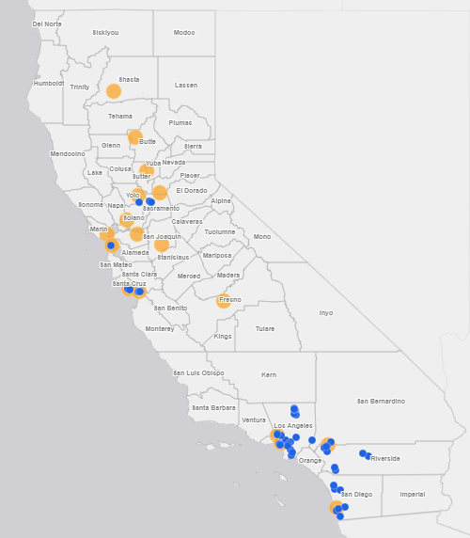
(n = 57)
August 2017
Notes:
When program implementation activities started in the 18 networks, there were 57 spokes.

Slide 13
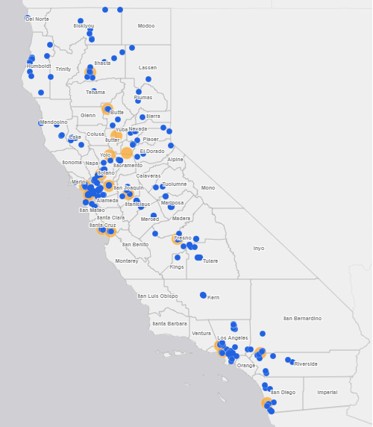
(n = 217)
January 2019
Notes:
By January 2019, there were over 200 spoke locations signed on, the majority of which were added in the rural northern counties, which have experienced the highest overdose death rates in the state.
50 of the 180 spokes that report data to UCLA started prescribing medications for opioid use disorders for the first time after joining the network. (note: some spoke locations report their numbers as part of a larger spoke organization – this is why the reporting number is slightly lower than the number of treatment locations)
39% of spokes are federally qualified health centers (FQHCs), meaning that they serve a rural or underserved area
28% serve rural communities
On the next few slides, we have some preliminary data on the numbers of patients and providers

Slide 14
New Patients Starting Medications for Opioid Use Disorders in Hubs and Spokes*
*Includes mean imputation for Hubs and Spokes missing/unable to obtain individual months’ reports
Notes:
Agencies serving as Hubs and Spokes began implementing the H&S program in August 2017.
We collected data from all Hubs and Spokes currently in the system, dating back to Jan 2017 (7 months prior to implementation).
During baseline (the time period prior to the dotted line), more patients were receiving methadone than any other medication for opioid use disorders.
By around April 2018, that trend reversed, and more patients started receiving buprenorphine than methadone. This speaks mostly to growth in the spokes.
This was due in part to the growth in the numbers of providers waivered to prescribe buprenorphine in spokes. By December 2018, there were 319 waivered prescribers in Spokes, an 82% increase over the first month of the program

Slide 15
Growth in Actively Prescribing Waivered Providers*
*Includes mean imputation for Hubs and Spokes missing/unable to obtain individual months’ reports
Notes:
This is slightly older data (from October), but we just wanted to provide a visual of what’s going on with providers who have a DATA 2000 waiver to prescribe buprenorphine in spoke settings.
Here you’ll see that there is a gap among providers who get waivered and those who actually start prescribing. From the start of the project through October, in any given month, only an average of 61% of providers are using their waivers to prescribe buprenorphine.
There are currently 319 providers in the system, and this trend in the rate of actually prescribing has continued, with 65% of waivered providers in Dec actively prescribing.
When we surveyed Hub and Spoke providers about their prescribing practices, those who were waivered but had never prescribed buprenorphine were less likely than active prescribers to feel that they had the mentorship they needed to effectively treat patients with OUD (p < .05). Other barriers included provider knowledge and attitudes, stigma toward OUD, reticence to start patients on buprenorphine, concerns over legal ramifications and other regulatory barriers.
To address the gap, the Hub and Spoke implementation team at UCLA has worked with Mark McGovern at Stanford to develop the Hub and Spoke Provider Facilitator program, which aims to get champion practitioners out into spoke settings to mentor providers who aren’t yet prescribing.

